Slide 1
Noble Gas Monitoring for Nuclear Accident Forensics
Steven Biegalski, Ph.D., P.E.
Nuclear and Radiological Engineering and Medical Physics

Slide 2
Outline
Noble Gasses
Detection Network
Radioxenon Forensic Signatures
Fukushima
Conclusions

Slide 3
Noble Gasses
The main noble gases of interest for CTBT monitoring include isotopes of xenon and radon.
Noble gasses have advantages for forensic measurements because:
They are more likely to leak from a reactor or underground test than other elements.
Minimal chemical reactions in environment to perturb forensic signature.
Creation at source can be relatively high.

Slide 4
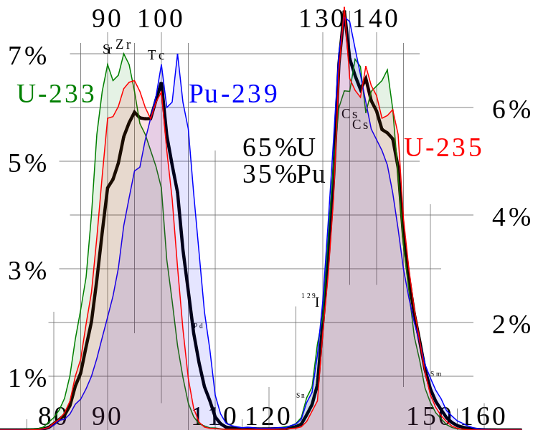
Radioxenon
Noble gasses are important for nuclear monitoring as they may not be easily filtered or contained
Xenon is a noble gas whose isotopes are produced in high yield from nuclear fission.
Argon is largely produced from activation.
This talk will largely focus on radioxenon within the context of monitoring for the Comprehensive Nuclear-Test-Ban Treaty (CTBT).
http://en.wikipedia.org/wiki/File:ThermalFissionYield.svg

Slide 5
Radioxenon (cont.)
Xenon gas is present in Earth’s atmosphere at a concentration of 0.087±0.001 parts per million.
Radioxenon may be produced through either activation or fission.
http://atom.kaeri.re.kr/

Slide 6
Radioxenon (cont.)
The four main radioxenon fission products of interest include ^{131m}Xe, ^{133m}Xe, ¹³³Xe, and ¹³⁵Xe.
They have good half-lives, production rates, and decay characteristics.
 | ^{131m}Xe | ^{133m}Xe | ¹³³Xe | ¹³⁵Xe
Half-Life | 11.9 days | 2.19 days | 5.24 days | 9.09 hours
²³⁵U Fission Yield Per 100 Fissions
Direct (%) – Thermal | 3.48 x 10⁻⁷ | 1.89 x 10⁻³ | 6.66 x 10⁻⁴ | 7.85 x 10⁻²
Direct (%) – Fast | 2.41 x 10⁻⁷ | 4.23 x 10⁻³ | 1.45 x 10⁻³ | 1.20 x 10⁻¹
Cumulative (%) – Thermal | 4.05 x 10⁻² | 1.95 x 10⁻¹ | 6.70 | 6.54
Cumulative (%) - Fast | 4.51 x 10⁻² | 6.72 | 1.98 x 10⁻¹ | 6.60

Slide 7
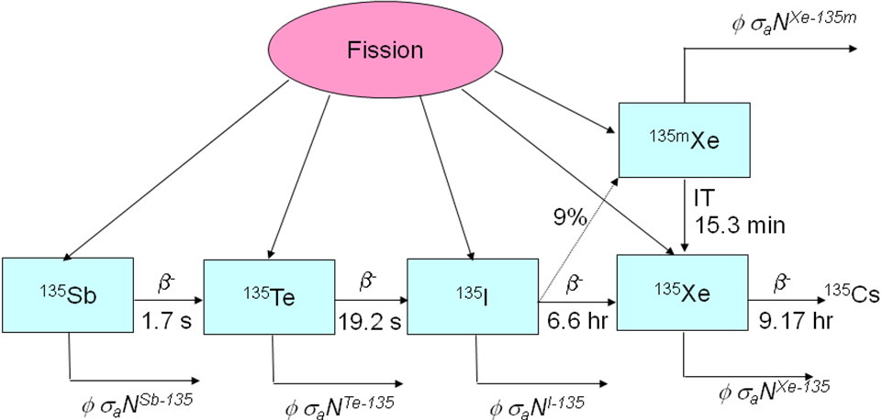
Radioxenon (cont.)

Slide 8
Radioxenon Sources
Type of Release | Order of Magnitude Radioxenon Released
Hospitals | ~ 10⁶ Bq/day/facility
Nuclear Power Plants | ~ 10⁹ Bq/day/facility
Radiopharmaceutical Facilities | ~ 10^{11 to} 10¹³ Bq/day/facility
Nuclear explosion underground | ~ 0 to 10¹⁵ Bq/kton
Nuclear explosion atmospheric | ~ 10¹⁶ Bq/kton
Saey, J. Environmental Radioactivity, 100, 396-406 (2009).

Slide 9
Radioargon
The radioisotopes of argon are also of interest for nuclear monitoring.
Radioargon isotopes are primarily produced through activation processes.
Some half-lives suitable for monitoring.
Isotope | Half-Life | Notes
³⁷Ar | 35.04 days | Produced primarily through ⁴⁰Ca(n,α)⁴⁷Ar with secondary production through ³⁶Ar(n,γ) ³⁷Ar reaction.
³⁹Ar | 269 years | Produced primarily through ³⁸Ar(n,γ) ³⁹Ar with secondary production through ⁴²Ca(n,α)⁴⁹Ar reaction.
⁴¹Ar | 1.8 hr | Produced primarily through ⁴⁰Ar(n,γ)⁴¹Ar. Short half-life does not facilitate regional monitoring.
⁴²Ar | 32.9 years | Produced from double neutron capture ⁴⁰Ar(n,γ) ⁴¹Ar(n,γ)⁴²Ar with secondary production from ⁴⁴Ca(n,γ)⁴⁵Ca (n,α)⁴²Ar. Low anticipated production.

Slide 10
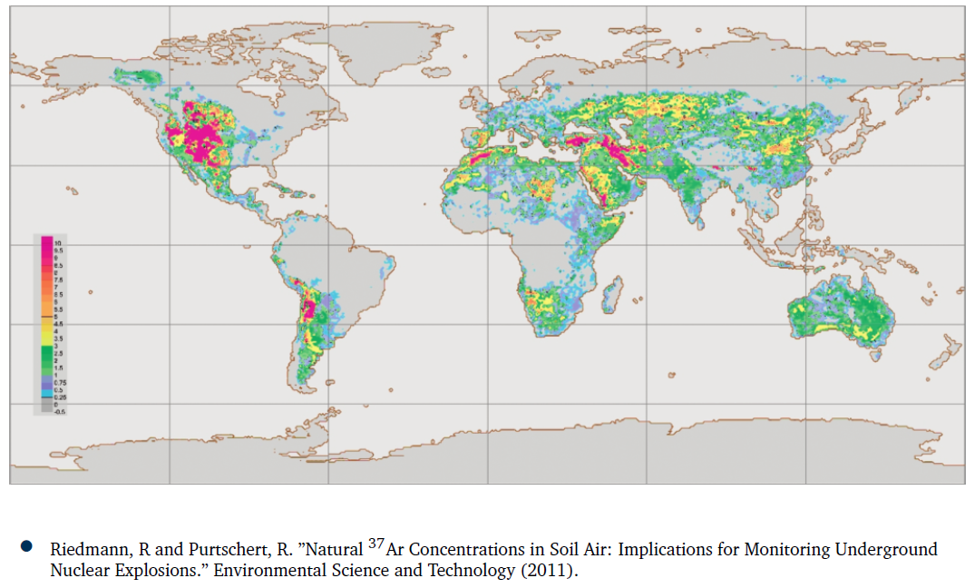
³⁷Ar World Background in Soil Air

Slide 11
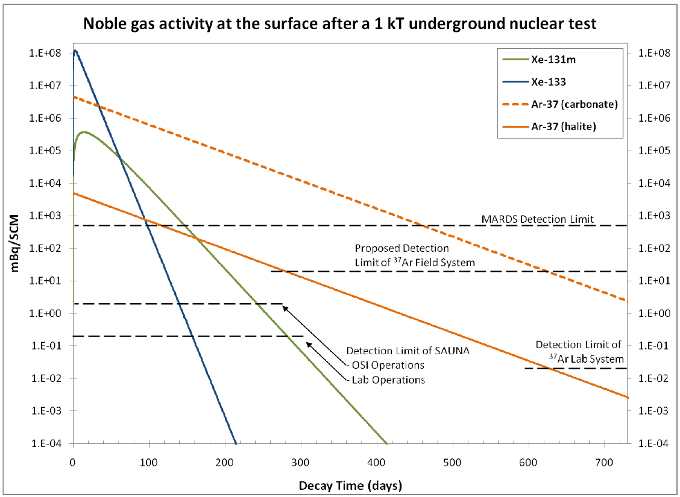
Surface Activity
Haas DA, HS Miley, JL Orrell, CE Aalseth, TW Bowyer, JC Hayes, JI McIntyre, “The Science Case for ³⁷Ar as a Monitor for Underground Nuclear Explosions,” PNNL Document PNNL-19458, 2010.

Slide 12
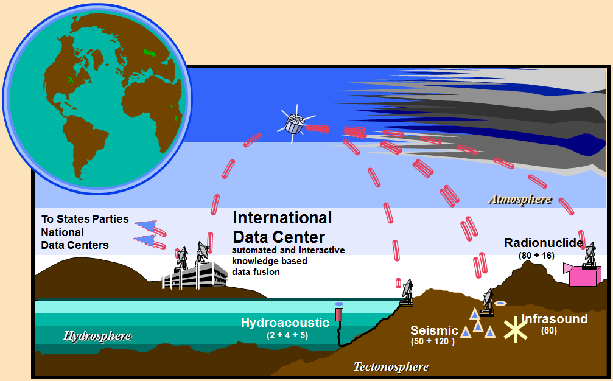
Detection Network
The Comprehensive Nuclear-Test-Ban Treaty (CTBT) defines an International Monitoring System (IMS).
The IMS consists of monitoring stations for:
Seismic
Infrasound
Hydroacoustic
Radionuclide

Slide 13
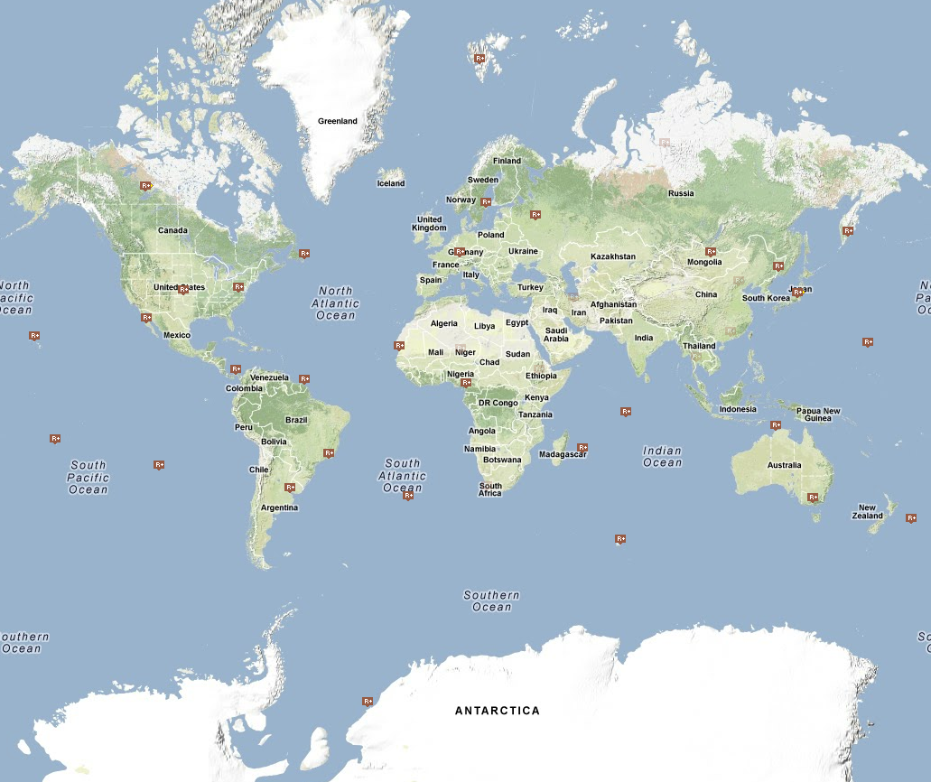
Detection Network (cont.)
Radionuclide detection consists of:
Particulate monitoring
Noble gas monitoring
Radioxnon is the predominant noble gas being measured.
Radioargon technology is still at an infant stage.
http://ctbto.org/map/

Slide 14
Radioxenon Forensic Signatures
Information may be determined about the source of radioxenon based on the content of the sample measured.
The more information you have, the better job you can do on a forensic analysis.
Other factors may also be utilized including:
Station history
Atmospheric Transport
Knowledge of local sources
Other measurements within IMS
Radionuclide measurements
Wave-form measurements

Slide 15
Radioxenon Forensic Signatures
At the time of CTBT signature in 1996, just the presence of ¹³⁵Xe in a sample was indicative of a nuclear weapon test.
Now system detection limits have improved to a point where some stations routinely see ¹³⁵Xe.
From Perkins and Casey ‘Radioxenons: Their Role in Monitoring a Comprehensive Test Ban Treaty,’
prepared by Pacific Northwest National Laboratory, June 1996, DOE/RL-96-51

Slide 16
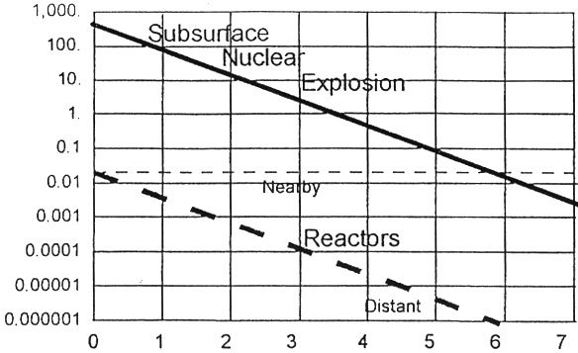
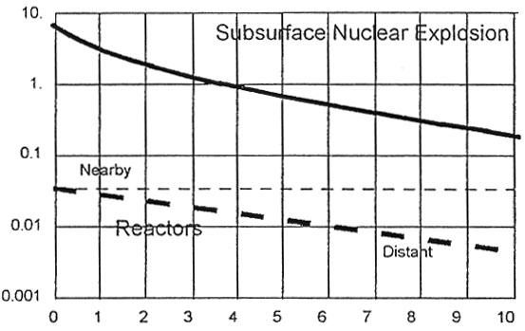
Radioxenon Forensic Signatures
The first step for isotopic ratios showed promise to distinguish between commercial reactor emissions and nuclear explosions.
Decay Time (day)
Decay Time (day)
From Perkins and Casey, ‘Radioxenons: Their Role in Monitoring a Comprehensive Test Ban Treaty,’ prepared by PNNL, June 1996, DOE/RL-96-51.

Slide 17
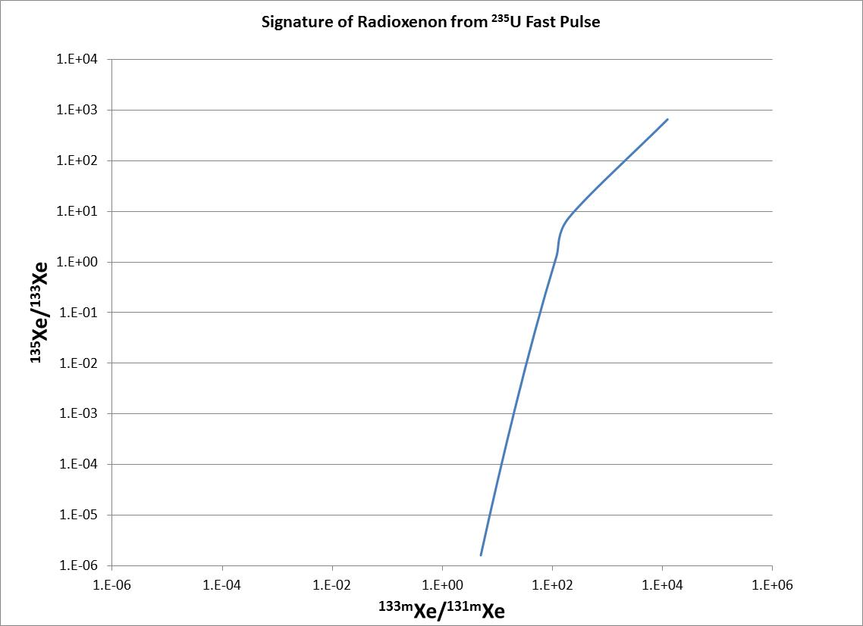
Radioxenon Forensic Signatures
The field has expanded to multivariate analysis techniques and multi-isotope ratio correlation (MIRC) plots.
This is basically a plot of ratios vs. ratios.

Slide 18
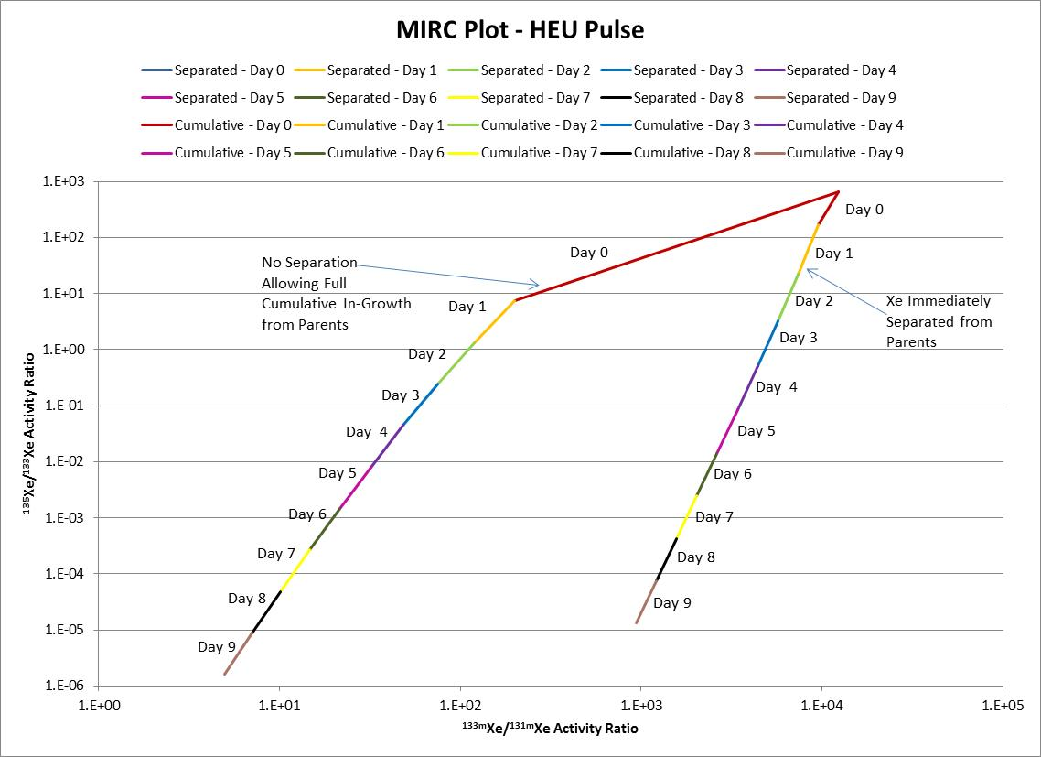
Radioxenon Forensic Signatures

Slide 19
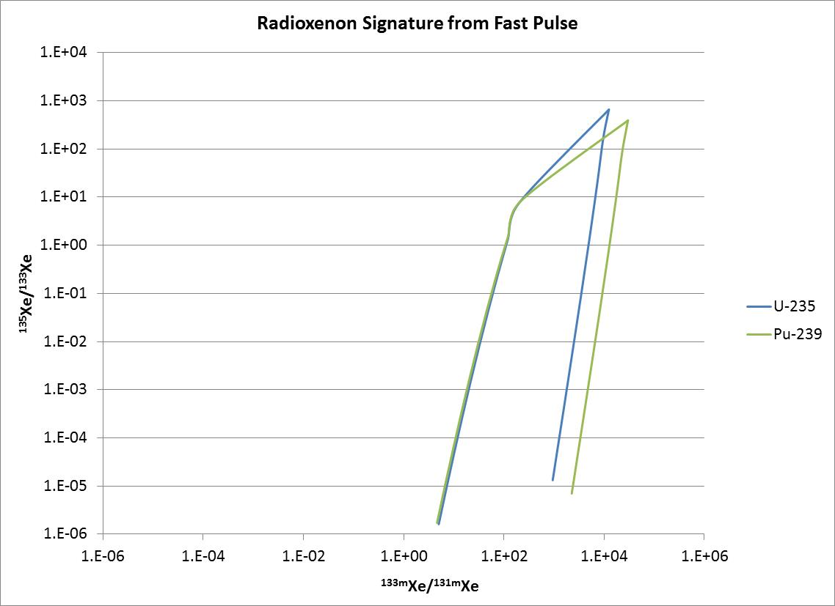
Radioxenon Signature ²³⁵U vs ²³⁹ Pu

Slide 20
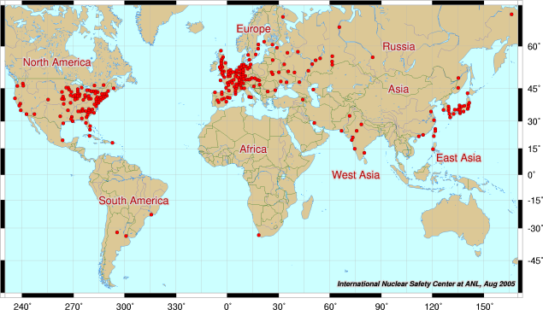
Commercial Reactors
There are 437 operating commercial reactors in the world today.
Most are thermal reactors operating 12 to 18 months between refueling.
Radioxenon releases from these facilities are measured.
http://nuclearinfo.net/Nuclearpower/CurrentReactors

Slide 21
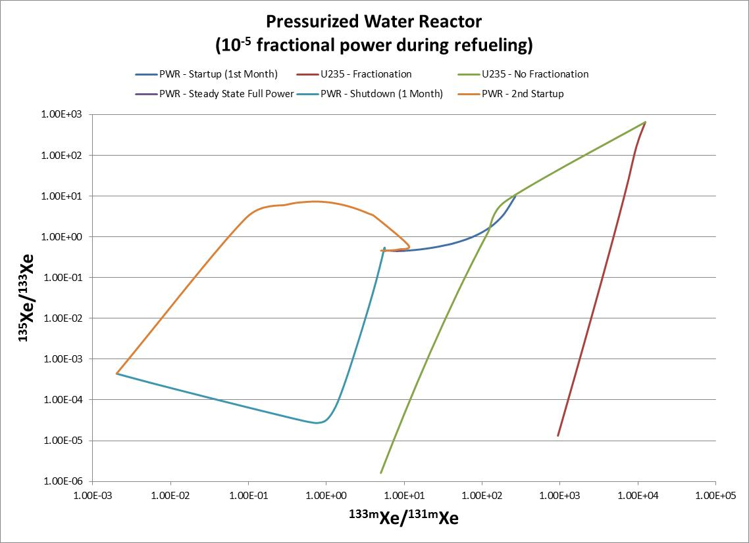
Commercial Reactors

Slide 22
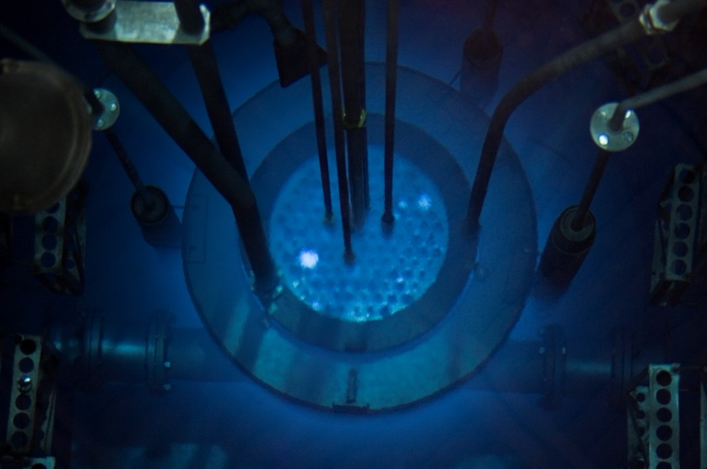
Research Reactors
There are many designs of research reactors around the world.
Radioxenon emissions are more from air activation than from fission due to neutron beam lines and other irradiation facilities.
The University of Texas TRIGA Reactor

Slide 23
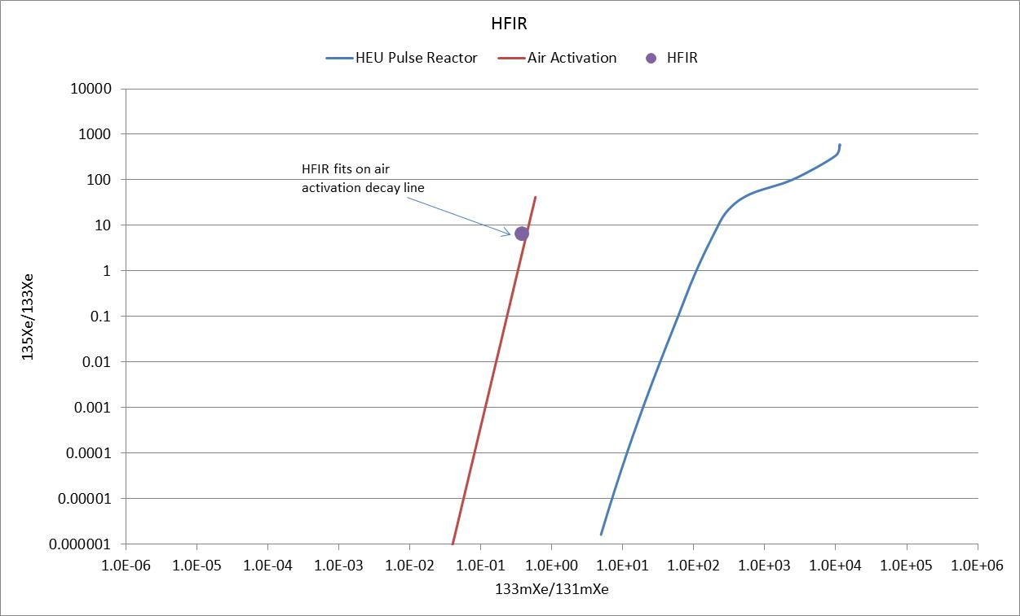
Air Activation – Research Reactors

Slide 24
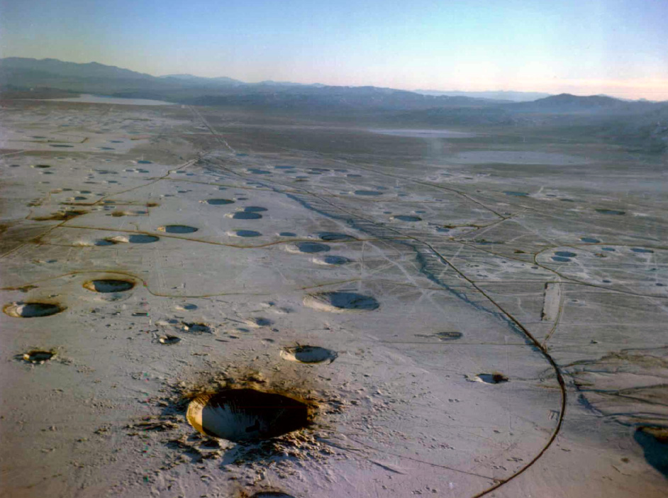
Underground Nuclear Test Signatures
The radioxenon source signature at the time of production is well established.
The Undergound Transport of Environmental Xenon (UTEX) code was developed to calculate the perturbations resulting during the process of radioxenon traveling to the surface.
Significant On-Site Inspection implications.
http://www.notpurfect.com/travel/nuke/nevada.html

Slide 25
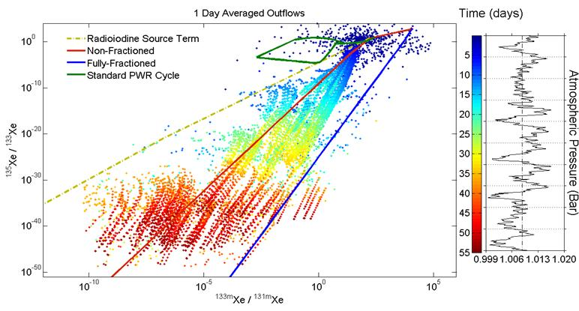
UTEX Sensitivity Study
Editor’s Choice in Science (vol. 339, 18 Jan. 2013)
JD Lowrey, S.R. Biegalski, AG Osborne, MR Deinert,” Subsurface mass transport alters the radioxenon signatures that are used to identify clandestine nuclear tests,” Geophysical Research Letters, 40, 1-5, 2013..

Slide 26
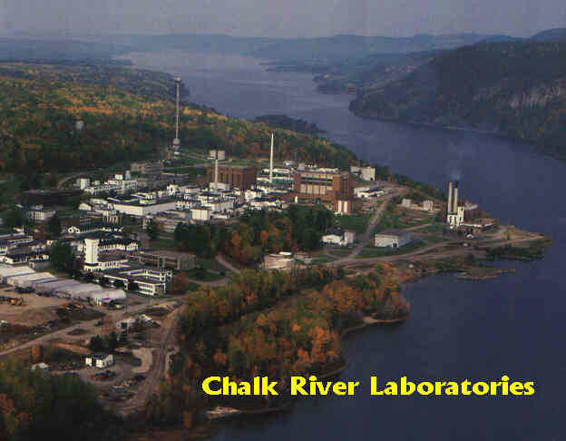
Radiopharmaceutical Production
Radiopharmacutical production via ²³⁵U target activation is a major anthropogenic source of radioxenon in the atmosphere.
Major production facilities include:
ANSTO, Australia
CNEA, Argentina
CRL, Canada
IRE, Belgium
NRG, The Netherlands
NTP, South Africa
http://www.nuclearfaq.ca/cnf_sectionB.htm

Slide 27
Medical Isotope Production - ⁹⁹Mo
 | ANSTO | CNEA | CRL | IRE | NRG | NTP | Average
Al |  | 16.5 | 36 | 30 | 26.46 |  | 27.24
²³⁵U | 2.5 | 1.4 | 2.23 | 4.2 | 5 | 7.15 | 3.75
Flux | 9.0E+13 | 1.5E+14 | 2.5E+14 | 1.5E+14 | 1.5E+14 | 1.5E+14 | 1.6E+14
Min Irradiation (hr) | 72 | 72 | 150 | 100 | 144 | 50 | 155.5
Max Irradiation (hr) | 336 | 168 | 280 | 150 | 144 | 200
Cooling (hr) | 11.5 |  |  | 36 | 20 | 112 | 44.875
Values from Saey , Bowyer, Ringbom, Applied Radiation and Isotopes, 68 (2010) 1846-1854

Slide 28
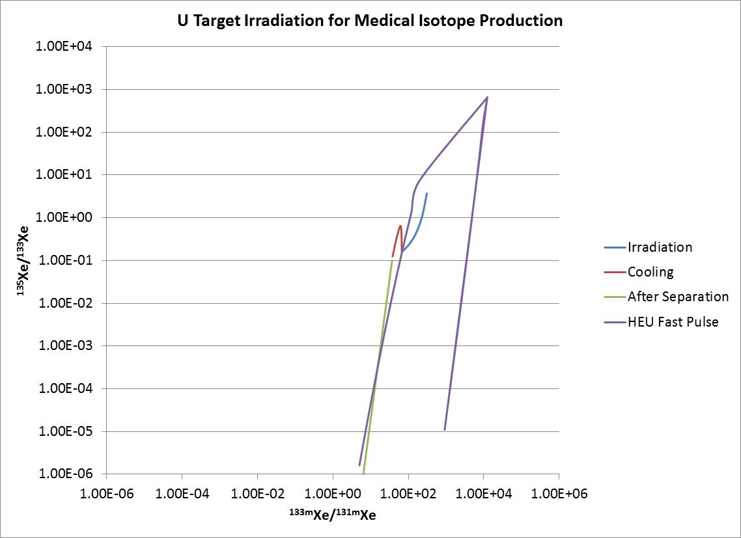
Nominal Medical Isotope Signature
Direct Overlap
of Signatures

Slide 29
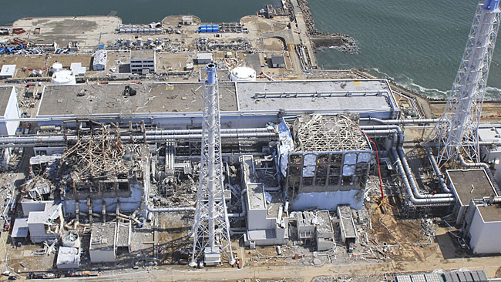
Fukushima Nuclear Accident
Radioxenon was instrumental in determining the accident severity for the 2011 nuclear accident at Fukushima Daiichi.
Radioxenon was detected in the United States within three days of the accident.
Radioxenon measurements provided the first confirmation of significant core damage in all three reactors that were operating at the time of the earthquake.

Slide 30
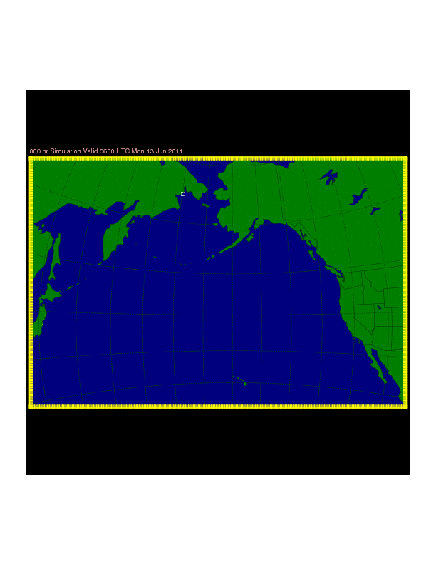
Note: This is just to
give you an idea. More
accurate plume models
have been generated
that show quicker
advancement of the plume
and wider diffusion.
http://forecast.chapman.edu/japan.php

Slide 31
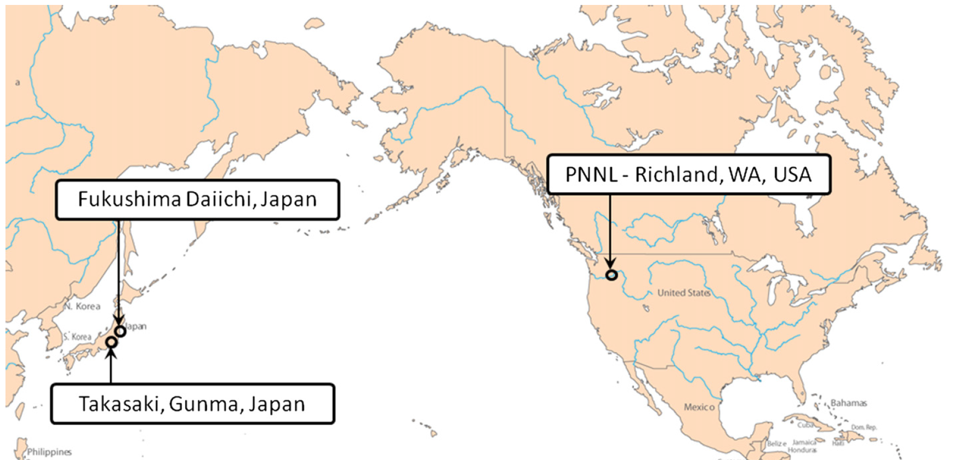
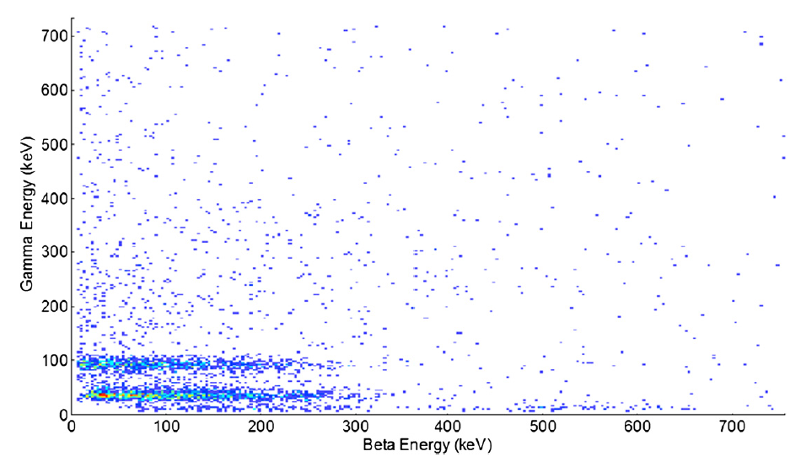
Fukushima (cont.)
First detections of ¹³³Xe were made starting early March 16 in Richland, WA, USA, only four days following the earthquake.
Maximum concentrations of ¹³³Xe were in excess of 40 Bq/m³, which is more than 40,000 the average concentration of this isotope is this part of the United States.
T.W. Bowyer, S.R. Biegalski, M. Cooper, P.W. Eslinger, D. Haas, J.C. Hayes, H.S. Miley, D.J. Storm, V. Woods, “Elevated Radioxenon Detected Remotely Following the Fukushima Nuclear Accident.” Journal of Environmental Radioactivity, 102(7), 681-687, 2011.

Slide 32
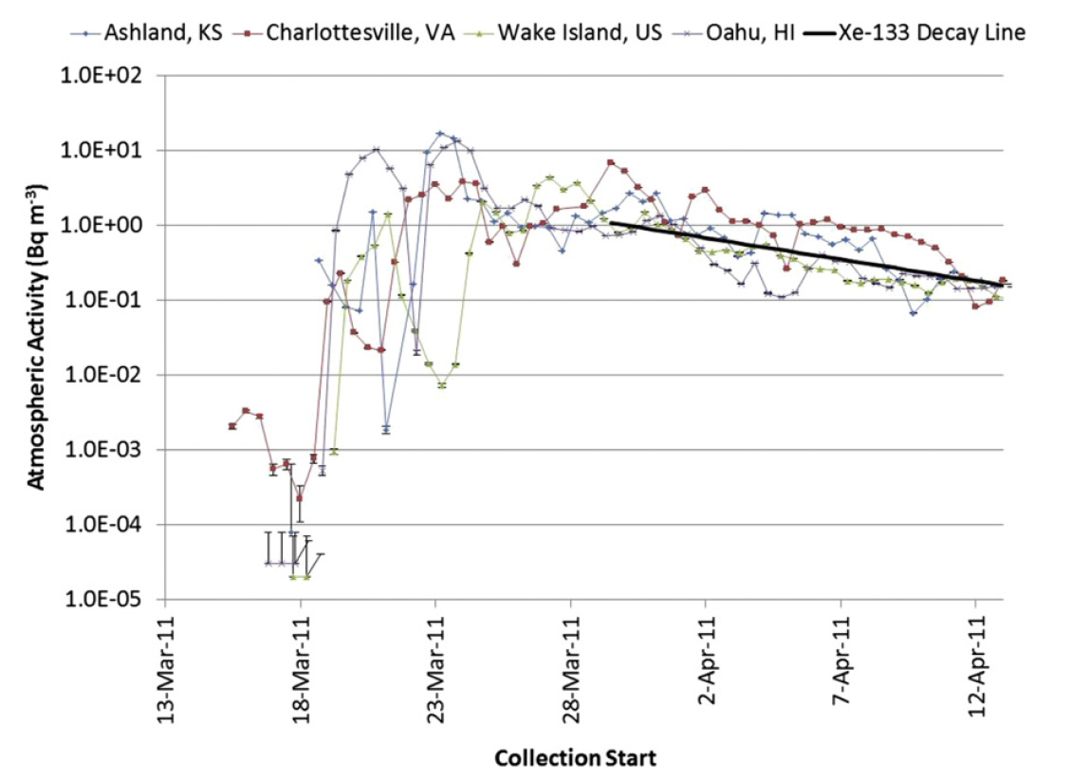
Fukushima (cont.)
Radioxenon isotopes were measured at all US IMS stations equipped with noble gas monitoring equipment.
¹³³Xe atmospheric activity concentrations measured
at the Ashland, KS,Charlottesville, VA, Wake Island, US, and Oahu,HI stations.
After initial release, decreasing trend matched the half-life of ¹³³Xe showing no further major releases into the atmosphere.
Time series of ¹³³Xe atmospheric activity concentrations for Ashland, KS, Charlottesville, VA, Wake Island, US, and Oahu, HI from March 11, 2011 to April 11, 2011.
S.R. Biegalski, TW Bowyer, P Eslinger, JA Friese, LR Greenwood, DA Haas, JC Hayes, I. Hoffman, M Keillor, HS Miley, M. Moring, “Analysis of Data from Sensitive U.S. Monitoring Stations for the Fukushima Daiichi Nuclear Reactor Accident,” Journal of Environmental Radioactivity, 114, 15-21, 2012.

Slide 33
Fukushima
¹³³Xe/^{131m}Xe isotopic activity ratio matched modeling of Fukushima reactor as a function of time.
Variation from station to station was attributed to calibration differences.
¹³³Xe/^{131m}Xe isotopic activity ratio for US IMS stations (1 σ error bars).
S.R. Biegalski, TW Bowyer, P Eslinger, JA Friese, LR Greenwood, DA Haas, JC Hayes, I. Hoffman, M Keillor, HS Miley, M. Moring, “Analysis of Data from Sensitive U.S. Monitoring Stations for the Fukushima Daiichi Nuclear Reactor Accident,” Journal of Environmental Radioactivity, 114, 15-21, 2012.

Slide 34
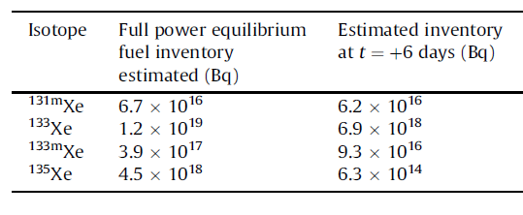
Unit 1, 2, and 3 Xe Inventories
T.W. Bowyer, S.R. Biegalski, M. Cooper, P.W. Eslinger, D. Haas, J.C. Hayes, H.S. Miley, D.J. Storm, V. Woods, “Elevated Radioxenon Detected Remotely Following the Fukushima Nuclear Accident.” Journal of Environmental Radioactivity, 102(7), 681-687, 2011.

Slide 35
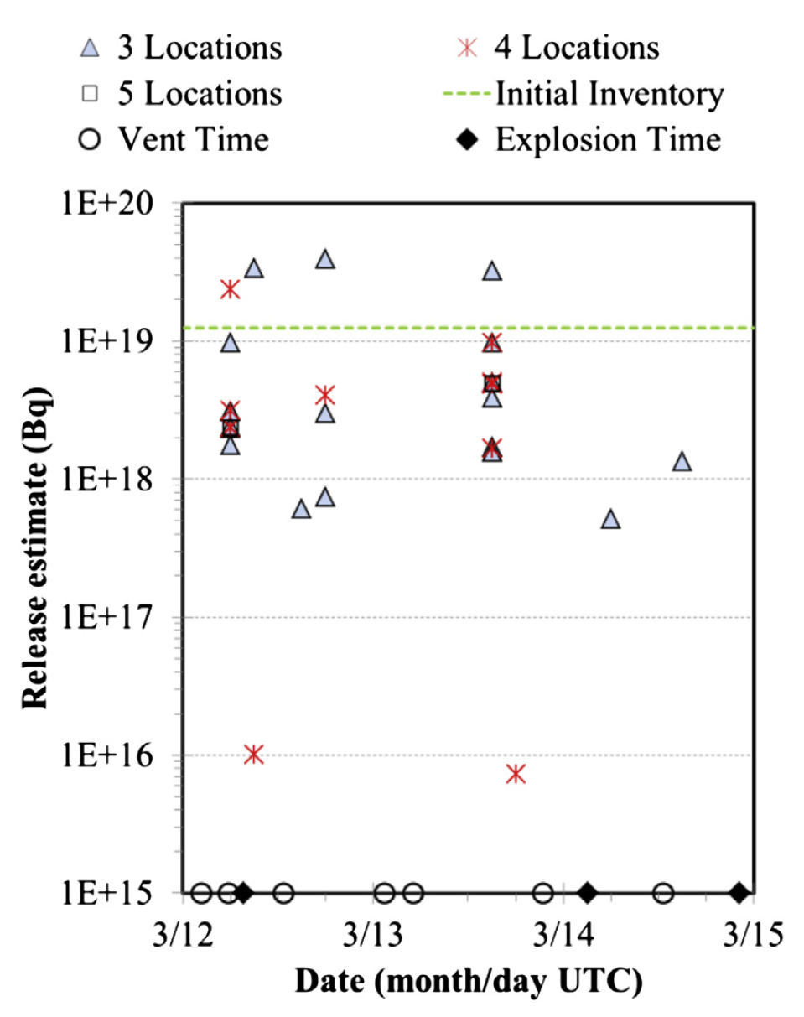
Fukushima
Modeled dilution factors at five different detection locations were combined with 57 atmospheric concentration measurements of ¹³³Xe taken from March 18 to March 23 to estimate the source term.
This analysis suggests that 92% of the 1.24 10¹⁹ Bq of ¹³³Xe present in the three operating reactors at the time of the earthquake was released to the atmosphere over a 3 d period.
Preliminary results roughly one week after the accident showed 85% to 103% of radioxenon inventory was released from the three reactors providing early confirmation of core damage.
These result show how radioxenon measurements show the extent of core damage in a nuclear accident scenario.
P.W. Eslinger, T.W. Bowyer, M.W. Cooper, D.A. Haas, J.C. Hayes, H.S. Miley, J.P. Rishel, V.T. Woods, S.R. Biegalski, I. Hoffman, E. Korpach, J. Yi, K. Ungar, and B. White,” Source term estimation of radioxenon released from the Fukushima Dai-ichi nuclear reactors using measured air concentrations and atmospheric transport modeling,” Journal of Environmental Radioactivity, 127, 127-132, 2014.

Slide 36
Conclusions
Radioxenon measurements may be a useful tool for the detection of nuclear events.
Detection sensitivity has significantly improved, so forensic signatures are necessary to identify sources.
Radioxeon is also useful to aid response efforts to nuclear events.

