Slide 1
Active Filter Tests for Radial and Axial Flow HEPA Filters Parallel Canisters for Carbon Filter Test
Luis Rudenas
Engineering and Capital Programs
Notes:
This presentation is about challenges presented in Active Filter Tests in Australian Nuclear Medicine Production Facilities with continuous production and use of filters. The filters used are HEPA filters and carbon filters.
The HEPA filters are constructed from pleated material type fiberglass and the production is similar to the paper production . The filters can be constructed in different shapes such as Radial, rectangular , circular and the manufacturers can adapt to suit Client requirements. The HEPA filters are used for particulates only and when tested is done in a continuous injection of aerosol with particulates of 0.3 microns . For testing the formula is p = 100 Cd/Cu. Need an injection manifold and sampling before and after the filter to check concentrations at both sides
The carbon filters is used for adsorbing gases. The most simple is a box with carbon and perforated pates at both sides. Also it can be arranged in an 1 “ or 2” V type. For Iodine 131 you need two inches of carbon at a very low face velocity. The carbon used is 8X16 Nuclear grade with 5% of TEDA impregnation. The method of test tat we use is by injecting a pulse of gas 1 Bromobutane checking upstream and downstream the filters . The same formula p =100 Cd/Cu is used. This is a mechanical efficiency test. To complement this test , parallel canisters of the same depth than the filters are installed in parallel with the filters. We take one sample canister per year and sent to USA for a Methyliodine test. In the past we used to inject Iodine to the Carbon filters and was a lot of safety implications.

Slide 2
Adopted standards for Active Filters tests at ANSTO
ASME AG1 Code on Nuclear Air and Gas Treatment
ASME N510-2002 Testing of Nuclear Air Treatment Systems
ASME N509-2002 Nuclear Power Plant Air-Cleaning Units and Components
ASTM 3803-89 Standard Test Method of Nuclear-Grade Activated Carbon
ASTM E300-03 Standard Practice for Sampling Industrial Chemicals
Notes:
The ASME AG-1 Code on Nuclear Air and Gas Treatment includes all the requirements for testing HEPA and Carbon filters.
ASME N510-2002 and ASME N509-2002 were used when we specified the filtration and method of test of the OPAL Nuclear Medicine and research reactor and are an excellent reference.
ASTM 3803-89 is used for the samples of canisters taken off from service and sent to a laboratory for test. The standard specifies all the conditions that this sample shall be tested using Methyliodine . A penetration result is given from the test and we take action to replace carbon filters if the penetration goes above 1% for a standard test at 30 Degrees C and 95% of humidity
ASTM E300-03 is used tor the design of samples taken directly from the carbon filters

Slide 3
Testing Filters Challenges with New NATS
Be able to calculate P(%) = 100 X Cd/Cu. Cu to be 1 to 10 ug/Litre. Aerosol uniformity for 2 or more filters.
HEPA radial filters installations with inlet and outlet plenums without access ducts to inject aerosols.
Difficulty to achieve aerosol uniformity. When possible individually test sets of radial flow HEPA filters.
Exhaust stacks with introduction of outside air to reduce stack height and increase velocity. Difficult to check flow or use as a downstream measuring point.
HEPA filter with small leakages detected on tests. Check the sealing surface of filters. Inspect and cover filters gaskets with vacuum sealing grease.
Difficult to install parallel canisters for carbon filters in limited spaces.
Notes:
Plenums only accessible in Plantrooms. Multiple access ducts are away in very radioactive areas with no operator access.
Aerosol uniformity injecting aerosol in plenums is difficult to achieve aerosol uniformity that is a requirement when testing multiple filters. For one filter only the aerosol uniformity is not required.
Exhaust fans use to be the ideal place to install the downstream sampling point for testing filters or for sampling the stack releases to atmosphere. Not anymore with mixing air exhaust fans used for fume cupboards.
Improve filter efficiency. The aim of the test is to achieve the maximum efficiency achievable and the critical area is the filter and filter housing interface that is the filter gasket. Testing personnel to be able to remove filters and reinstall as needed.
The design of parallel canisters is required to be economic and easy to fit in any place.

Slide 4
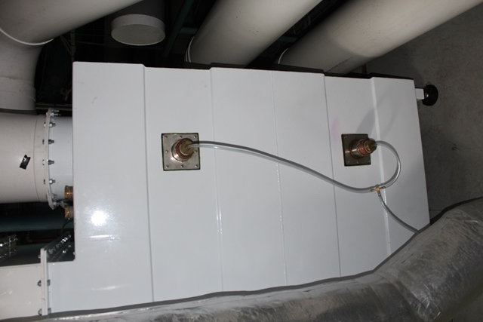
Radial HEPA Filters
Possible Locations of Upstream Manifolds
Upstream 100%
Manifolds
Housing of Two Radial HEPA Filters
Notes:
We have here the example of two radial filters , one above the other in a filter housing.
The problem is multiple ducts from Fume Cupboards connected to the filter housing.
Injecting the aerosol is difficult unless we use multiple aerosol generators to cover all the ducts.
We solve here the issue of sampling upstream the filters . Aerosol uniformity was achieved and two sampling upstream manifolds are installed to be connected together when testing

Slide 5
Injection Manifolds
Injection Manifold in Each Individual Duct. Multiple Aerosol Generators
Gasket Sealing with Silicone of standard 2” BSP Socket

Slide 6
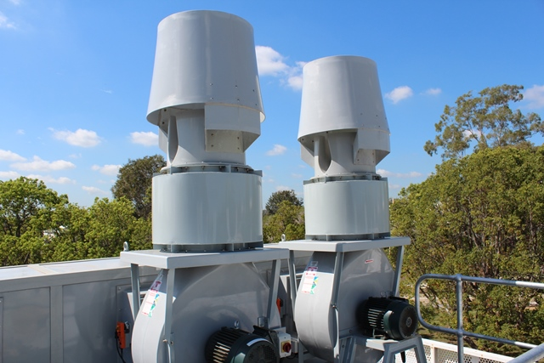
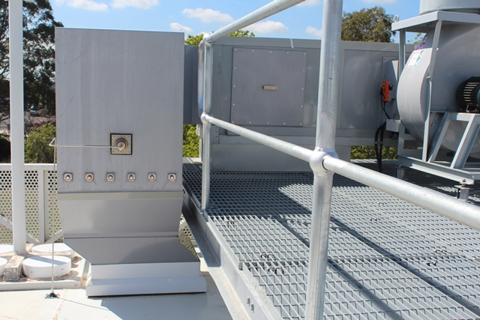
Downstream Sampling
Axijet High Plume Dilution Fan and
Strobic Air Designs. Shorter Stacks
Outside Air is Mixed with Laboratories Flows
No Possible to Use Downstream Sampling
Air Flow Station
Sampling Downstream

Slide 7
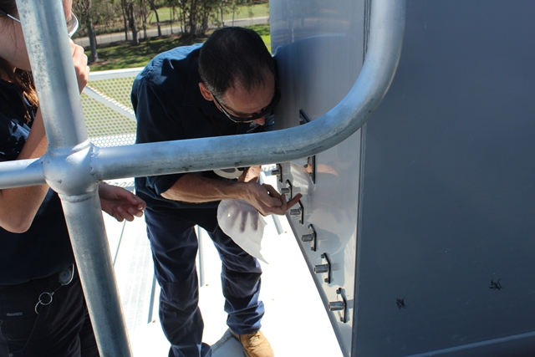
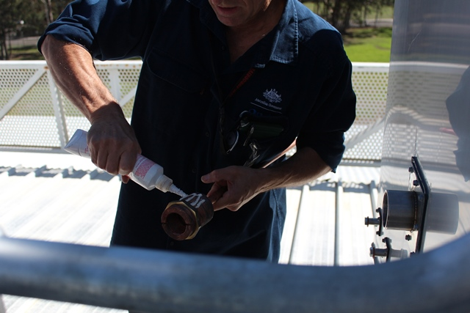
Installation Details
Manufactured Sockets ½” SS for plastic ducts.
For Stainless Steel ducts ½” Nutserts are used.
Station for Air Flows and Aerosol Uniformity tests.
Thread Sealing of Manifold
Used for Downstream Filter Test and Stack Monitoring
Loctite 569 is the Sealant. Plumbers tape not recommended

Slide 8
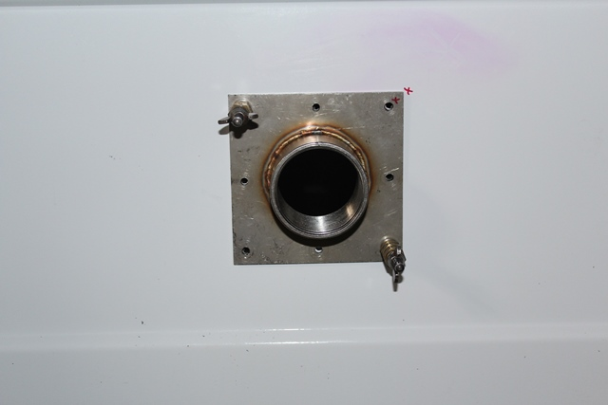
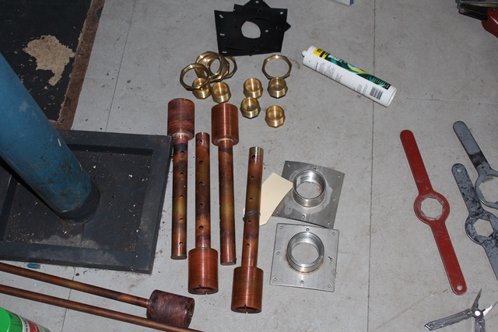
Standardised Manifolds
Retrofitting in Existing Installations
Manufactured Socket 2” BSP .
TEK screws used for fixing in plastic ducts.
Stainless steel blind rivet used in metal ducts..
For New Installations Welding Socket to SS Ducts is the Best Option.
Details of Manifolds and Fittings.
Copper Construction with 1” and ½” diameter. Holes Staggered every 2”. Area of Holes 1.25 of the Cross Section Area of Manifold.

Slide 9
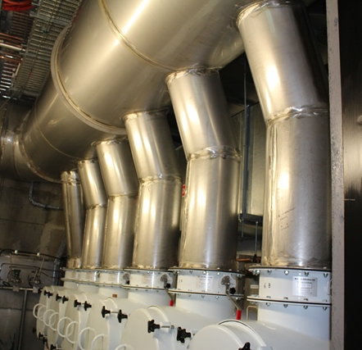
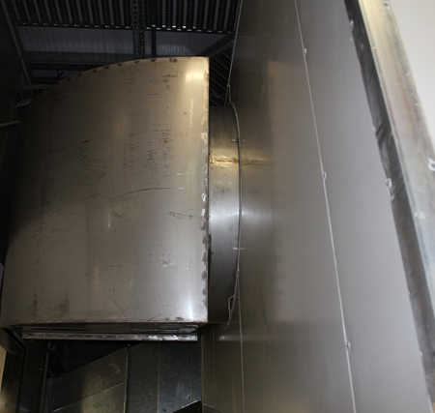
Ductwork In Limited Spaces
Duct Outlets of Radial Filters
Outlet Duct from Radial Filters to exhaust plenum

Slide 10
Injection Manifolds for Radial HEPA Filters
Three Injection Manifolds in Plenum
Manifold with an Extension

Slide 11
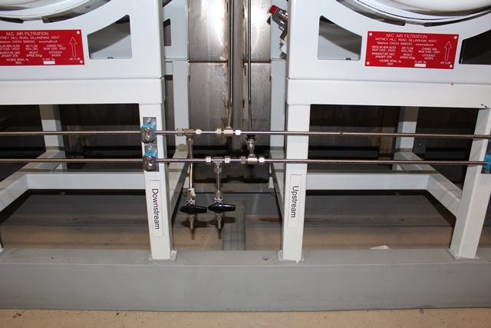
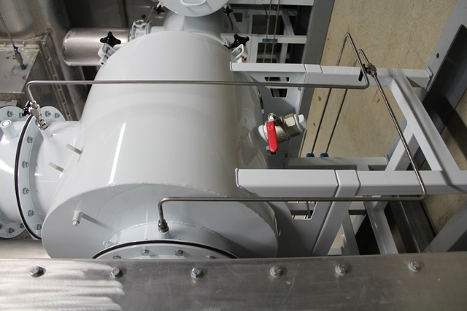
Radial HEPA Filters Sampling Points
Downstream and Upstream
Sampling Points. Swagelock fittings used.
No welding on site required. Recommended
to install in all filter test to reduce plastic hoses
Downstream valve and Sample
Upstream
Sample
Upstream
Valve

Slide 12
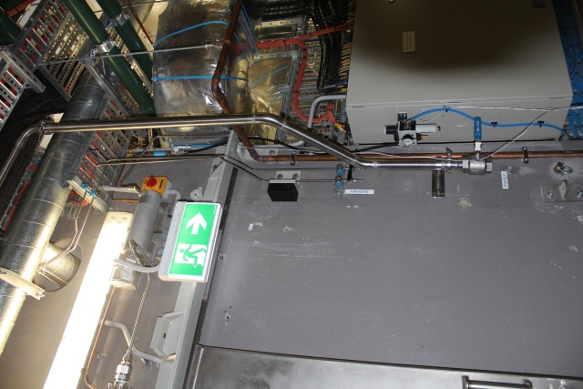
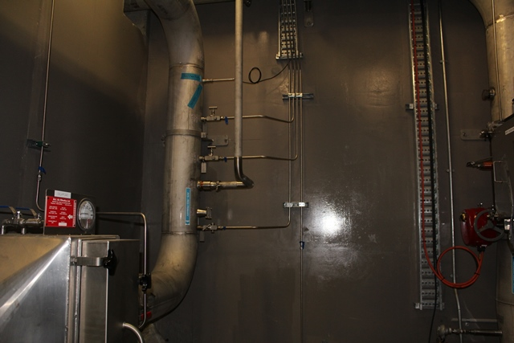
Filter Test in Areas of High Radiation
Injection Manifold in a High Radiation Area Connected to the Outside Room. Triclovers used on site. All SS Welds performed in Workshop.
Sampling Remote Injection

Slide 13
Prefilters and HEPA Filters Replacement
Fully Gowned with P3 Masks
Ventilation On. No Production
HEPA Filter Replaced. Static Pressure at twice the New Filter Pressure.

Slide 14
Test of Axial Flow HEPA Filter 24” X 24” X 12”
Prefilter
HEPA Filter
Scanning Box
Redundant.
Not being used
Aerosol Injection Manifold
Nutserts for Uniformity Test
Upstream 100%
Manifolds

Slide 15
Achievements
Upstream 4 Micrograms per Litre of Aerosol Concentration
Downstream 0% of Aerosol Concentration

Slide 16
Instrumentation for 1 Bromobutane Pulse Test of Carbon Filters to Determine Mechanical Efficiency
NUCON Model HGPH Pulse Mode Halide Generator
NUCON Model F-2000-HD ppm and ppb halide detector
NUCON Model F-2000-BBD ppb Halide detector
NUCON Model F-1000-CR calibration rig
Calibration gases 200 ppb and 36 ppm of 1 Bromobutane with corresponding clean air cylinders
Parallel canisters installed to complement the Pulse Halide Test and check performance of carbon to ASTM 3803-89. Penetration at 30 degrees C and 95% humidity standard conditions 2” Deep carbon.
At P 1% start organising filter change. At 3% replace carbon filter

Slide 17
Testing Carbon filters
Halide Pulse Injection
Two Carbon Filters to be tested
Halide Detectors Upstream and Downstream

Slide 18
Design of a Set of 6 Canisters 10” Long

Slide 19
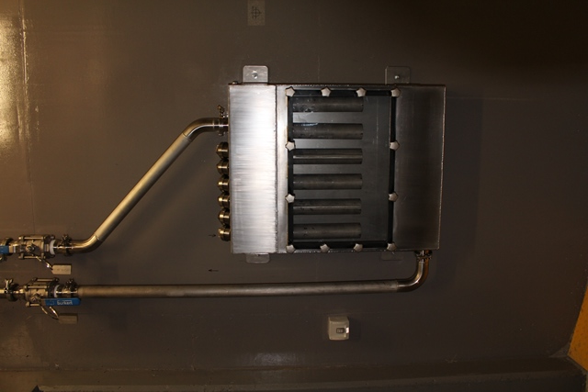
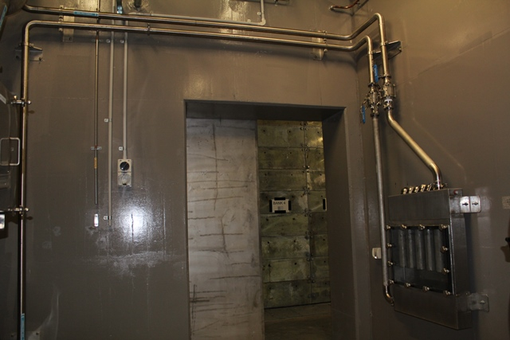
Parallel Canister Installation
10” Long Canister
Perspex Cover
Flow Direction
Canister Box
Pipe Connection to Canisters
Full Canister Box

Slide 20
Design of a Set of 6 Canisters 2” Long

Slide 21
Back of 2” Canisters with Triclover connection from lower plenum

Slide 22
Canisters 2” Deep Retrofitted in a Type IV Carbon Filter Housing
Removing Canister
Clear View Through Perspex Cover
Inlet and Outlets 2” diameter to Canister Box

Slide 23
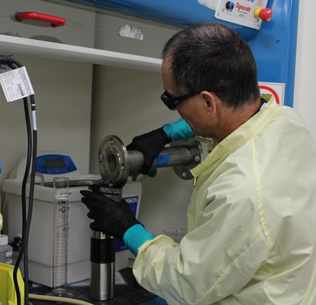
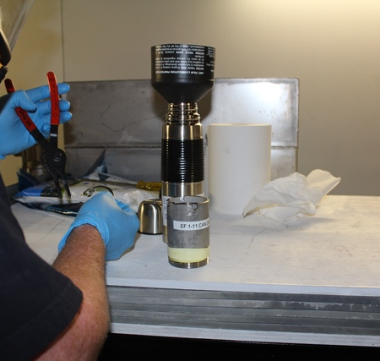
Transport of Carbon for Test to ASTM 3803
Filling Thermo for Carbon Transport
Emptying Canisters in a Fume Cupboard

Slide 24
Conclusions
Consult with the active filter tests specialists early in the design stage to reduce costs.
Install permanent fittings for filter testing.
Consider radiation exposure of personnel testing the filters and install remote testing points away from radiation.
Testing filters personnel to achieve maximum efficiency of installed filters. Check seals and reinstall filters if minor leakages detected.
Install parallel canisters to check performance of carbon to ASTM 3803-89
International Society for Nuclear Air Treatment Technologies 35th Nuclear Air Cleaning Conference -Charleston, SC, June 3-5, 2018

Slide 25
International Society for Nuclear Air Treatment Technologies 35th Nuclear Air Cleaning Conference -Charleston, SC, June 3-5, 2018

