Slide 1
Development of a Low Flow HEPA Filter
for Radiological Applications
Mark T. Sorna, Puget Sound Naval Shipyard
Bremerton, WA USA
Note: The views presented are those of the speaker and do not necessarily represent the views of the DoD, Navy or its components.

Slide 2
Summary
Intro – Temporary Nuclear Systems
Current State
New Filter Design
Flow Analysis
Review of AG-1, Section FC
Recommendations

Slide 3
Servicing Nuclear Systems
Temporary Systems
Flexible Radiological Glovebag Containments
Collection Tanks and Bottles
Low flow rates
No current requirements for nuclear filters with rated flow rates below 20 acfm

Slide 4
Temporary Systems Components

Slide 5
Filters For Temporary Nuclear Systems
Current State
Higher Flow Rate – ASME AG-1, Section FK
Low Flow Rate – Respirator Filters are Common
Glovebags
American Glovebox Society (AGS) recommends use of 2 cfm respirator filters

Slide 6
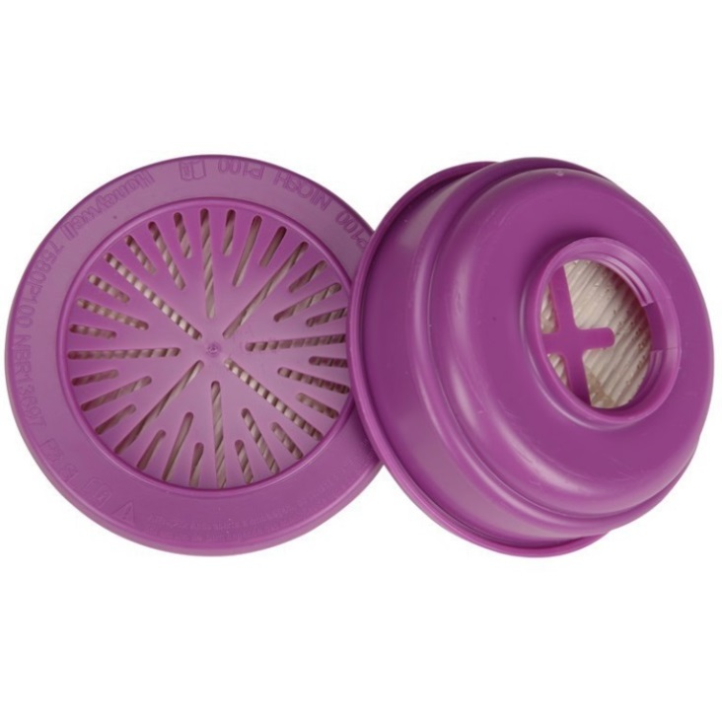
NIOSH Respirator Filters

Slide 7
NIOSH Respirator Filters
Requirements per 42 CFR 84
The Occupational Safety and Health Administration (OSHA) requires respirators be certified by National Institute for Occupational Safety and Health (NIOSH)
NIOSH test requirements are different than ASME AG-1 Requirements

Slide 8
NIOSH Respirator Filters
No Rough Handling Test
No Test for Strength and Water Repellency After Gamma Irradiation
Pressure and Velocity Gradients Present in Positive Pressure Applications Not Accounted For in NIOSH Testing
NIOSH Filters Have Custom Attachment Schemes – Complicates Their Use

Slide 9
New Filter Design
Design Goals:
Minimize Case Size
Medium Velocity < 5 ft/min (2.5 cm/s)
Minimize Velocity and Pressure Gradients
Case designed to handle operating and test loads
Design For Easy Attachment
Minimize Manufacturing Costs

Slide 10
New Filter Design
Injection Molded
Case and Screen
Nuclear Grade Media
Integrated
Baffle
Injection Molded Nut
And Rubber Gasket

Slide 11
New Filter Design
Nut Tightened
Finger-Tight
Filter Installed
On Glovebag Wall

Slide 12
Airflow Analysis Using CFD
Airflow Modeled in ANSYS Fluent
Filter Media Modeled Using Linear Darcy Porous Media Model
$ΔP=\left(\frac{μ}{α}v\right)t \frac{1}{α}=\frac{ΔP}{μvt}$
Where:
ΔP is pressure loss
μ is viscosity
v is velocity
t is the media thickness
α is the permeability, 1/α is the viscous resistance coefficient

Slide 13
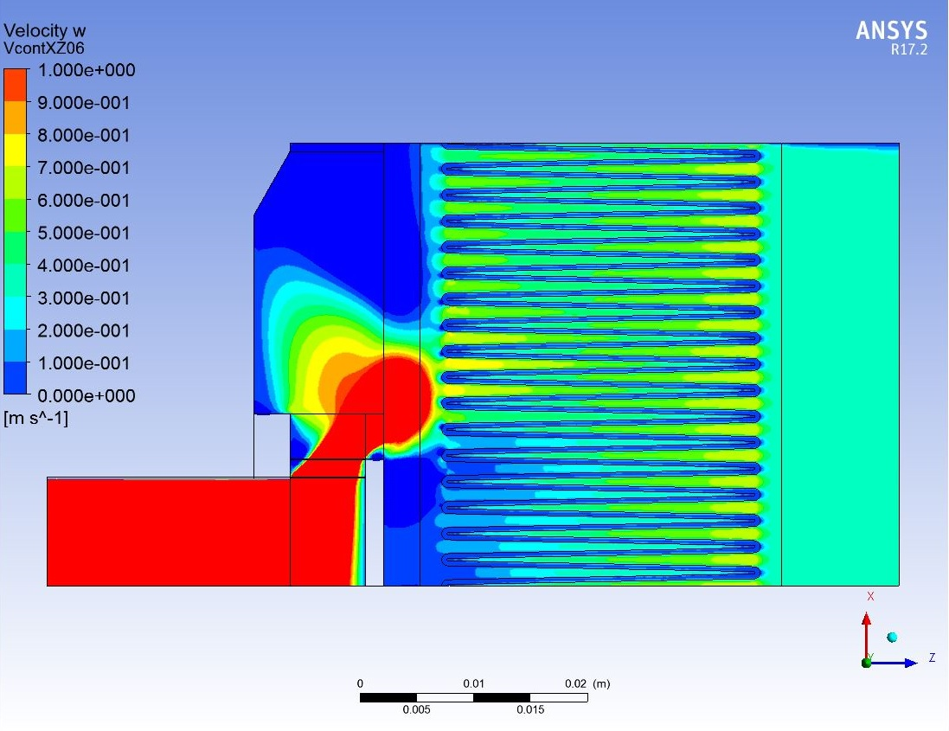
Results of Analysis

Slide 17
Evaluation of Existing AG-1 Code
Section FK will pertain only to radial filters so Section FC is reviewed
FC-1000 Introduction
Amendment to scope to cover temporary systems
Temperatures for temp systems do not generally reach 250 ºF

Slide 18
Section FC Evaluation
Article FC-3000 Materials
Material addition for Injection molded material
Paragraphs FC-3200 & FC-3210 (Special Limitations and Alternate Materials) should apply
Article FC-4000 Design
Need new paragraph covering non-rectangular filters
Additional gasket options and faceguard options

Slide 19
Section FC Evaluation
Article FC-4000 Design (continued)
Paragraph FC-4200 (Performance Requirements) unchanged
Paragraph FC-4300 (Seismic) not necessary for temporary system filters
Article FC-5000 Inspection and Testing
Similar for temporary systems
Evaluation needs to be done of the existing equipment (Q-76 and Q-107 penetrometers) for suitability to testing at low flow rates.

Slide 20
Article FC-5000 Evaluation
Rough Handling Test (FC-5130) required
Resistance to Pressure (FC-5140) needs evaluation for applicability and feasibility
Resistance to Heated Air (FC-5150) and Spot Flame Resistance (FC-5160) not required for filters on temporary systems
Structural Requirements (FC-5170) and Inspection (FC-5200) applicable

Slide 21
Recommended Test
Resistance to Crushing
Applies to smaller nipple connected filters installed by hand
Side load on case simulating the human grip on the case during installation
Load direction parallel and perpendicular to pleats
Load based on human pinch and grip strength
Resistance to airflow and Test Aerosol Particle Penetration performed after crush test

Slide 22
Article FC-6000 Through FC-9000
Requirements would remain similar but adjusted
Mandatory Appendix FC-I requirements would be the same for filters used in temporary systems

Slide 23
Conclusion and Recommendation
A new low-flow-rate HEPA filter for use in temporary nuclear systems has been developed and Code requirements have been evaluated
A new Code section is recommended that covers special HEPA filters used for temporary nuclear systems
Requirements for temporary nuclear systems are different from permanent systems used in nuclear facilities
New Code section could be expanded to include other temporary systems such as vacuum cleaners

