Slide 1


HEPA Filter Failure Modes at Elevated
Pressure, Temperature and Moisture
by
Werner Bergman and Gerard Garcia¹
Aerosol Science, LLC, Stanwood, WA, wbergman@aerosolscience.com
¹Consultant, gerardgarcia.me@gmail.com
International Society for Nuclear Air Treatment Technologies
33rd Nuclear Air Cleaning Conference ● June 22-24, 2014 ● St. Louis, MO

Slide 2
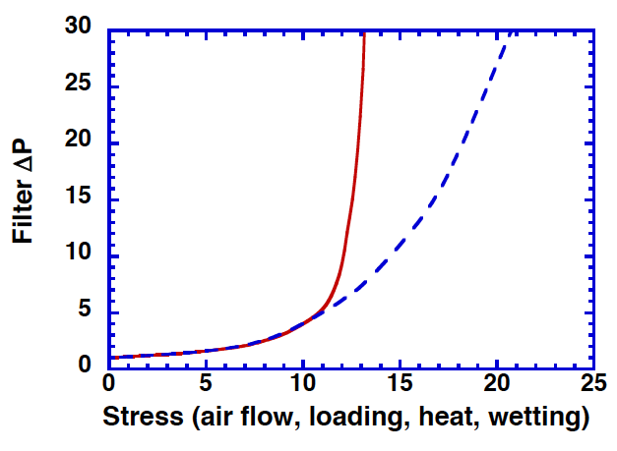
Two HEPA filter failure modes are analyzed
w/o
separator
tears
2
pleat collapse
w
separator
1

Slide 3
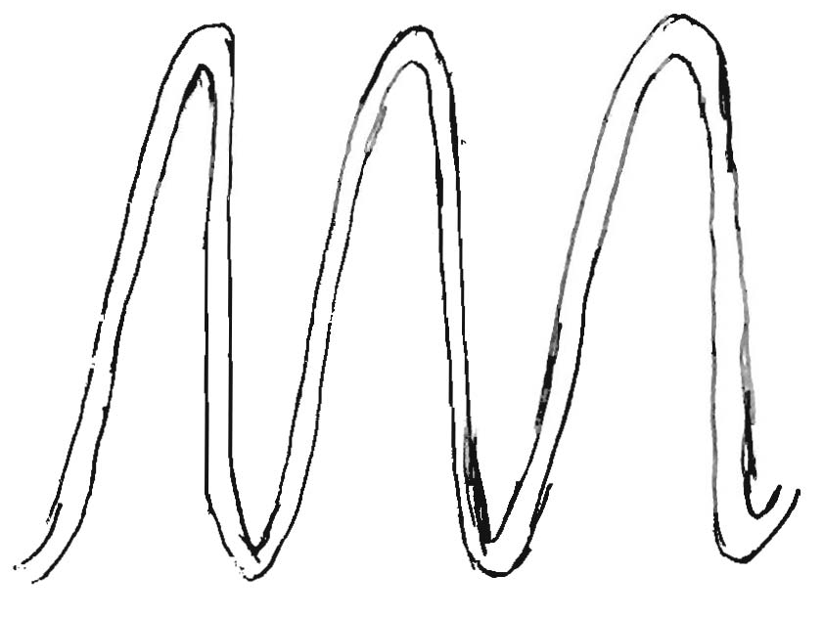
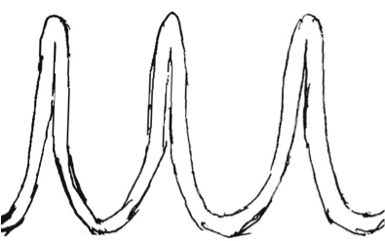
Stress on HEPA filters w/o separators causes pleat collapse
Stress can reduce stiffness (via heat or wetting) or increase pressure drop (via air flow or loading)
Stress

Slide 4
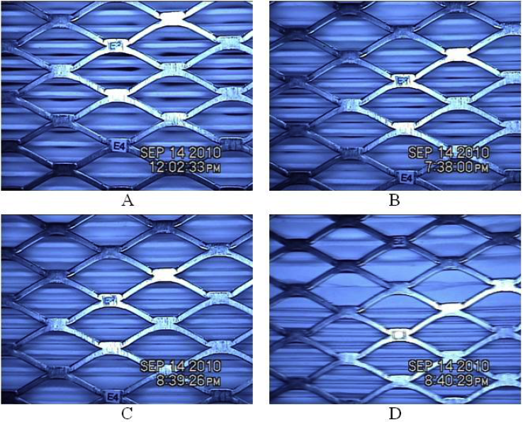
Camera on exit side of filter shows pleat collapse at increasing ΔP
4 in. WC
10 in. WC
20 in. WC
32 in WC
Giffin et al, 2012

Slide 5
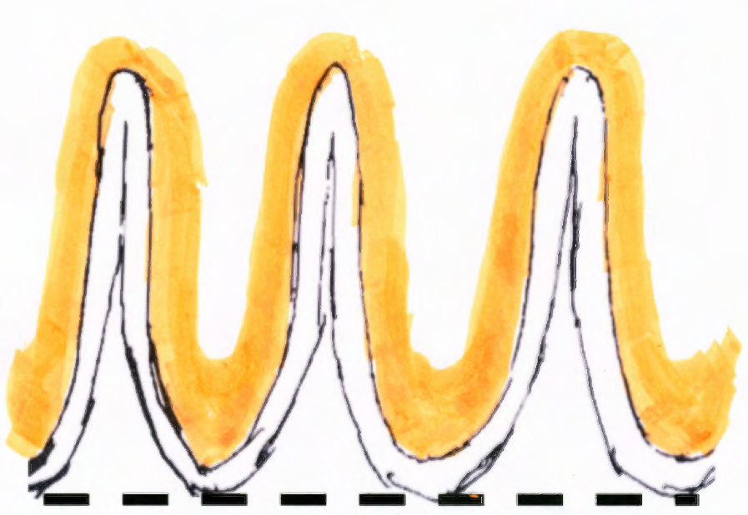
Particle deposits that conform to the medium pleats add to the pleat stress

Slide 6
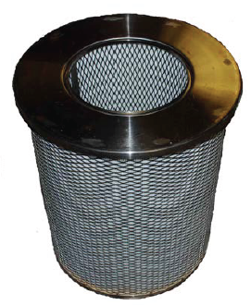
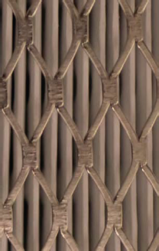
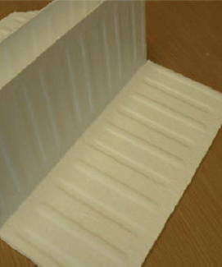
HEPA filters w/o separators were used
to study failure modes
Radial flow HEPA
Filter pleats
Embossed medium
Giffin et al, 2012

Slide 7
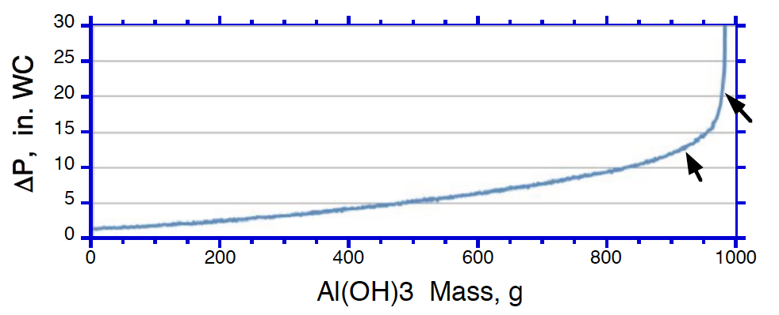
Particle loading is used to stress the HEPA filters
ICET used Al(OH)3 , carbon black and Arizona Road Dust
tear
end
Pleat
collapse
start
Giffin et al, 2012

Slide 8
Statistical analysis was used to
Determine ΔP for pleat collapse
12 tests from Giffin et al, 2012 were grouped by temperature and by the filter design- SC or RC
Each group of data was assumed to be normally distributed
The data groupings were changed to improve outcomes

Slide 9
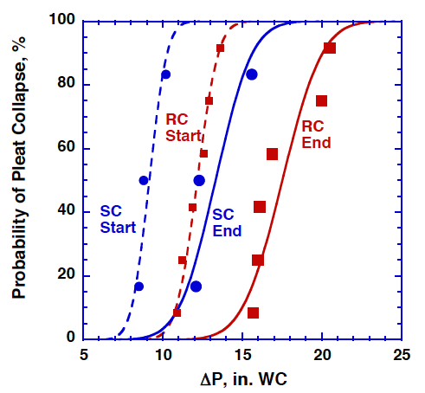
The SC and RC filters were analyzed for pleat collapse by particle loading
All particles (CB, Al(OH)₃ , and AZ) were included

Slide 10
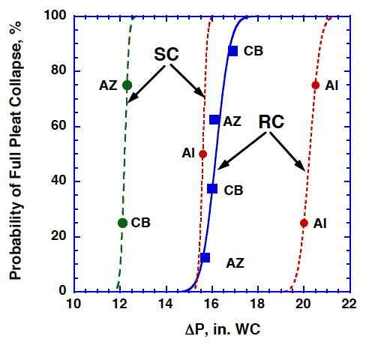
The pleat collapse by Al(OH)₃ loading was significantly higher than by the other particles

Slide 11
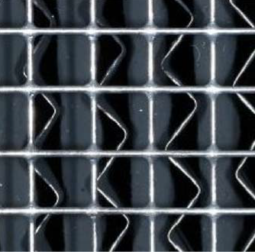
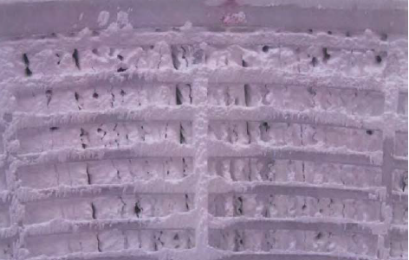
The higher pleat collapse by Al(OH)₃ loading was due to a rigid deposit covering the pleats
The rigid deposit of Al(OH)₃ was partially supported by the pleat ends and did not contribute fully to pleat collapse.
Carbon black deposits
Al(OH)3 deposits

Slide 12
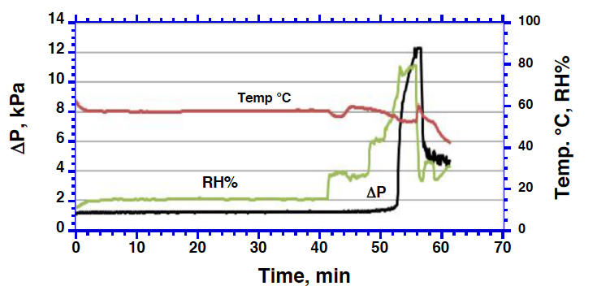
High temperature and increased humidity was used to stress partially loaded HEPA filters
HEPA filters were preloaded to 4 in. WC with Al(OH)₃ particles prior to the stress tests
pleat collapse
Giffin et al, 2012

Slide 13
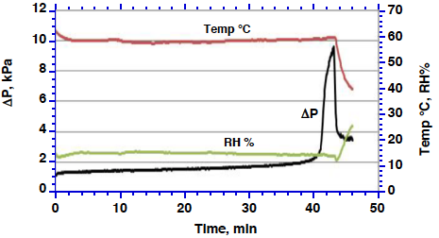
High temperature at low humidity was used to stress partially loaded HEPA filters
HEPA filters were preloaded to 4 in. WC with Al(OH)₃ particles prior to the stress tests
pleat collapse
Giffin et al, 2012

Slide 14
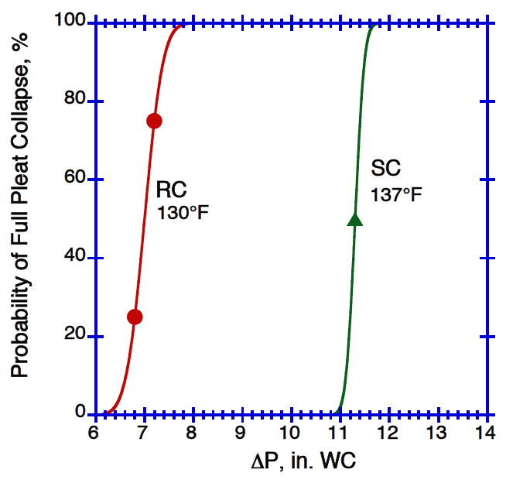
Analyses at elevated temperature show RC filters have pleat collapse at lower ΔP than SC filters.

Slide 15
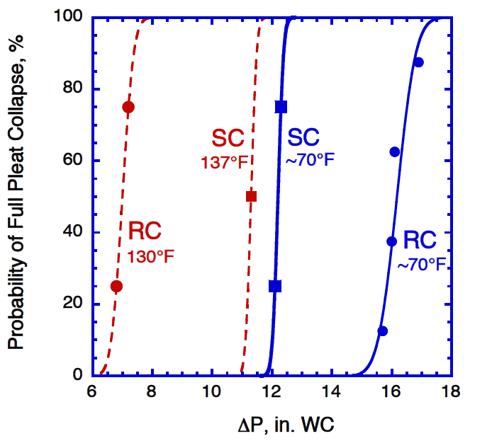
Summary of ICET tests shows pleat collapse with radial flow HEPA filters depends on two factors
1
Tightness of filter pack (RC>SC)
2
Separation inside pleats (SC>RC)

Slide 16
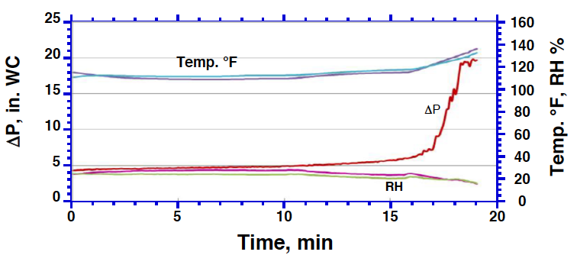
Pleat collapse also occurs with axial flow HEPA filters w/o separators (U-pack)
Pleat collapse

Slide 17
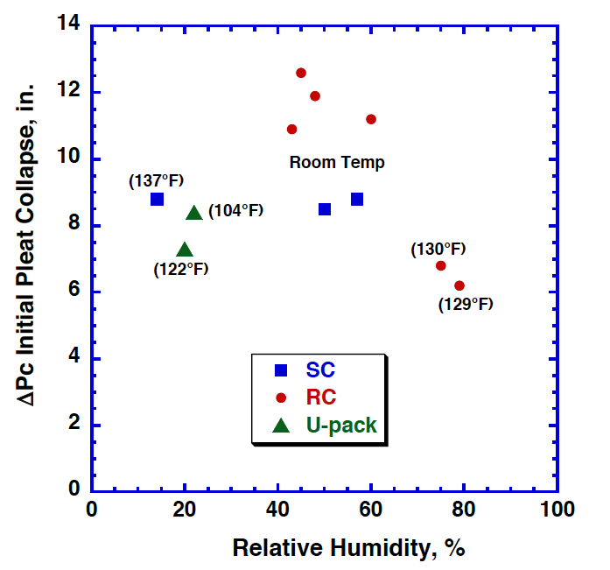
ICET studies show RH < 70% has no effect on filter pleat collapse

Slide 18
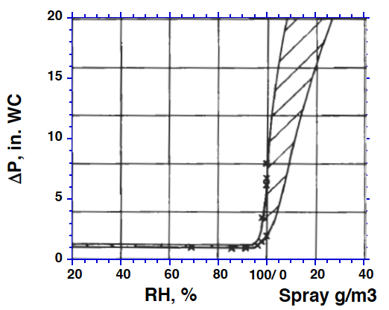
Other studies show clean HEPA filters increase in ΔP above 95% RH at 122°F
Rudinger et al, 1985

Slide 19
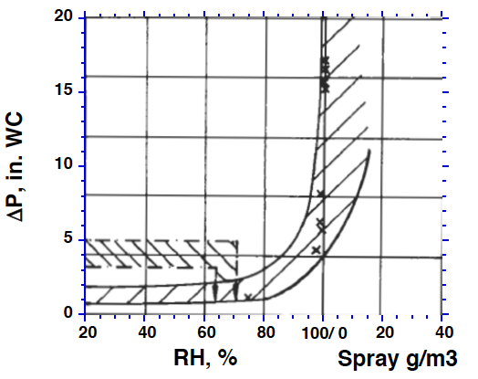
Other studies show loaded HEPA filters increase in ΔP above 70% RH at 122°F.
The increased ΔP due to adsorbed water is likely cause of pleat collapse in the ICET study.
Rudinger et al, 1985

Slide 20
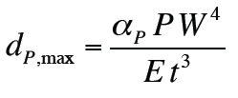
Theory of pleat collapse is based on plate deflection formula of Young and Budynas (2002)
d_{P,max} = maximum deflection
a_{P} = a constant that depends on the D/W ratio,
W = width between separator peaks or embossments
D = pleat depth
P = applied pressure on the sheet
E = Modulus of elasticity
t = thickness of medium

Slide 21

When the maximum medium deflection equals half the pleat space, the filter pleat has collapsed
1/N₀
2X₀
D
2X_{i}
1/N_{i}

Slide 22
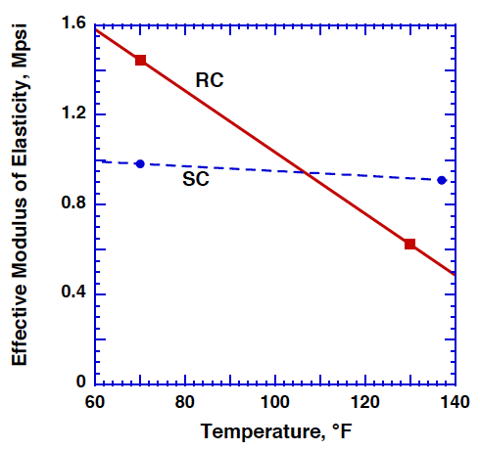
Theory was used to determine the effective modulus of elasticity for the radial flow filters
Further improvements are needed to separate filter design elements from the modulus of elasticity.

Slide 23
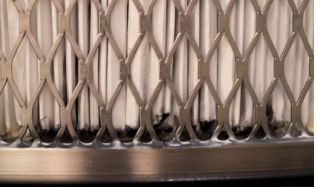
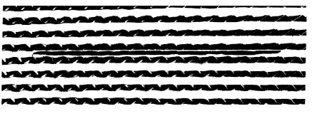
At higher stress levels, HEPA filters fail due to medium tears from 2 mechanisms
1
Bending of the filter pack
Waggoner et al, 2012
2
Pleat rupture
Gilbert et al, 1995

Slide 24
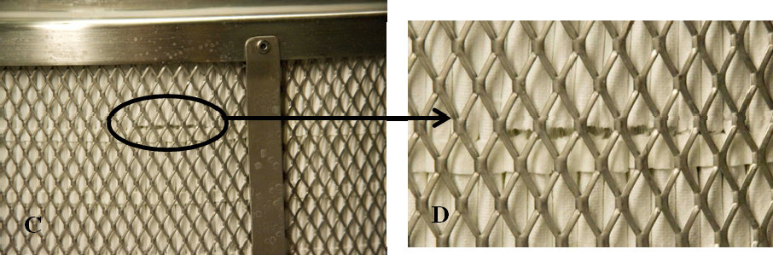
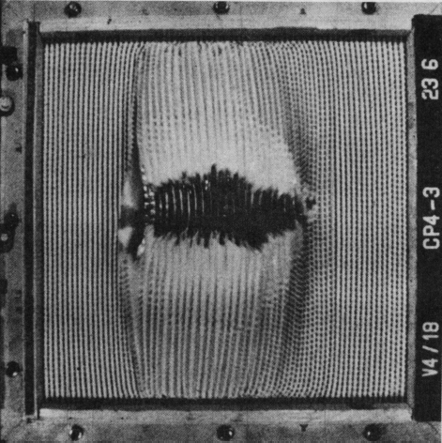
The location of the tears from pack bending is at the highest stress location
Bending of the filter pack near sealant, by ribbon separator
Giffin et al, 2012
Bending of the filter pack w/o screen
Rudinger et al, 1990

Slide 25
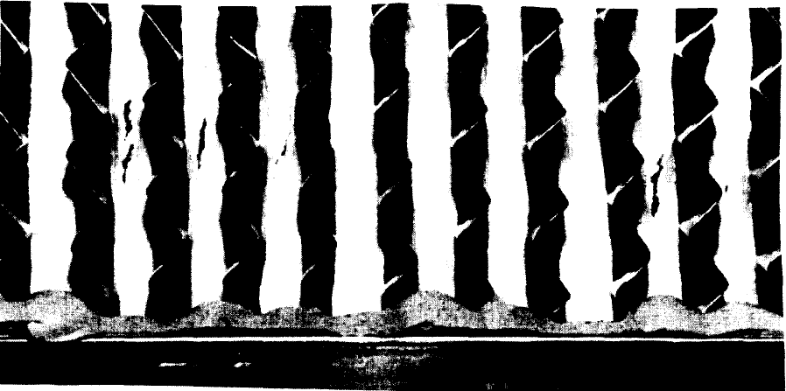
Tears from pleat swelling and rupture occur with weak media, especially when wet
Tears from the AG-1 wet overpressure tests typically occur on the downstream pleats near the bottom sealant filter side by the sealant.
This is the weakest and wettest and location due to water drainage.
Gilbert et al, 1995

Slide 26
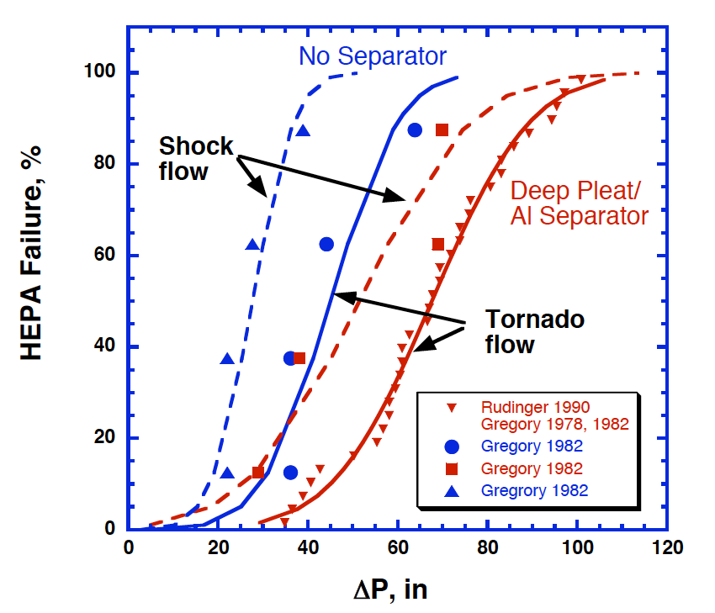
Stress tests showed separatorless HEPA filters were weaker than filters with separators.

Slide 27
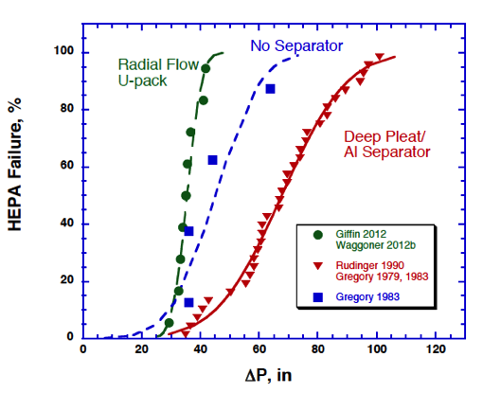
Stress tests showed separatorless HEPA filters were weaker than filters with separators.
There is a common ΔP failure threshold independent of filter design

Slide 28
Wetting filters dramatically reduces filter strength.
Tests apply to axial flow, deep pleat, aluminum separators, 1000 cfm,

Slide 29
AG-1 wet overpressure test approximately follows the statistics of wet filter failures
Typical failure mode is pleat rupture of water weakened medium

Slide 30
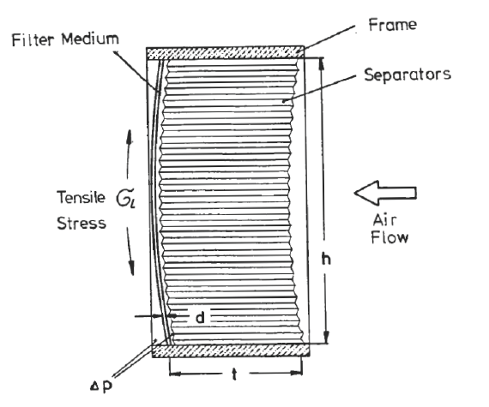
Theory of filter failure by bending of filter pack
Rudinger et al, 1987, 1990

Slide 31
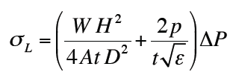
Theory of filter failure by bending of filter pack
σ_{L} = the tensile stress on the filter medium
W = width of the HEPA filter pack
H = height of the HEPA filter pack
D = depth of the medium pleats
t = thickness of HEPA filter medium
p = pitch of the separator corrugation
ε = elongation of the medium due to loading in %
ΔP = pressure drop across the HEPA filter pack
Rudinger et al, 1990)

Slide 32
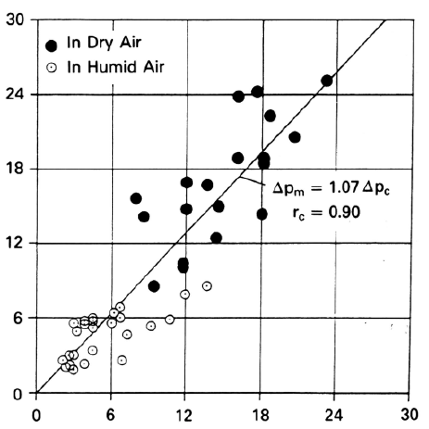
Theory of filter pack bending is in approximate agreement with experiments
ΔP Measured, kPa
ΔP Calculated, kPa
Rudinger et al, 1990)

Slide 33
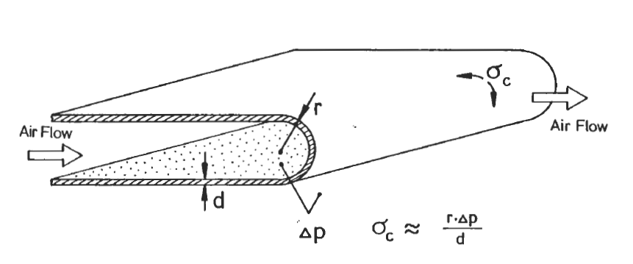
Theory of filter failure by swelling and
rupture of pleats
The theory does not include the cutting of the medium by the corrugated separators.
Rudinger et al, 1990)

Slide 34
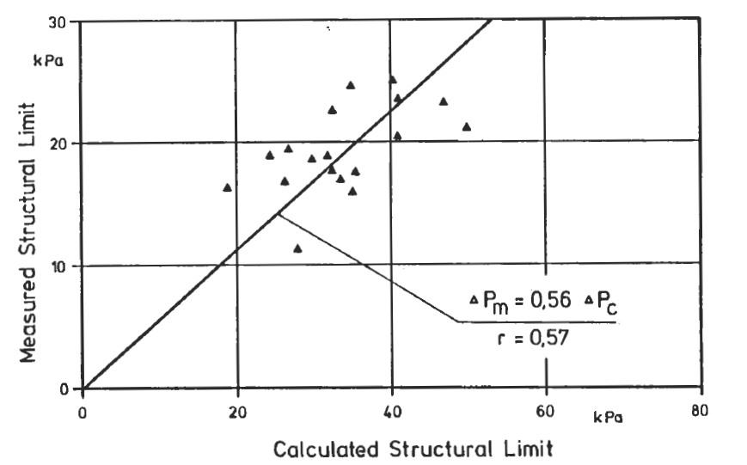
Theory of pleat rupture is in approximate agreement with experiments
Theory can be improved by include medium cutting by separators
Rudinger et al, 1987)

Slide 35
Conclusions
Statistical analysis was used to understand HEPA filter failure modes of pleat collapse and medium tears.
ICET tests were used to analyze pleat collapse
  Found ΔP at pleat collapse depends on filter design and temperature for RH < 100%
  Developed theory of pleat collapse based on plate deflection
Medium tears by filter pack bending and pleat rupture were analyzed statistically and the theories reviewed.

