Slide 1
Nuclear Ventilation Regulations and Standards in the UK
Bernard Swinnerton
Sellafield Ltd
Warrington WA3 6GR, UK

Slide 2
Content
The UK Nuclear Industry
Sellafield Site and its Work Themes
The Regulation of UK Nuclear Licensed Sites
UK Legislation, BS, EU and ISO Standards
Complying with Regulations and Legislation
UK HEPA Filter Standards and Type Testing
UK Ventilation Engineering Standards

Slide 3
The UK Nuclear Industry
36 Nuclear licensed sites
Power stations
- operational
- decommissioning
- under construction
Fuel manufacture
Fuel reprocessing
Nuclear submarines
Nuclear weapons
Nuclear waste stores

Slide 4
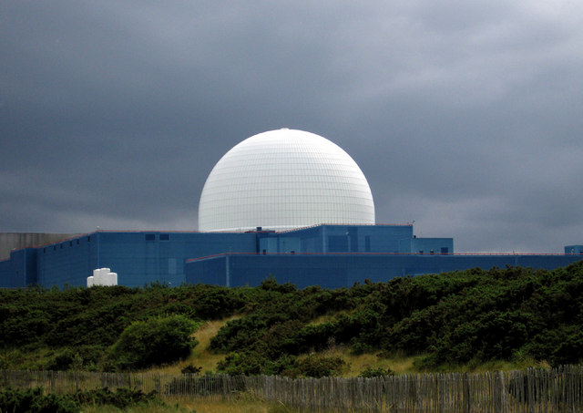
UK Nuclear Power Stations
Sizewell B PWR

Slide 5
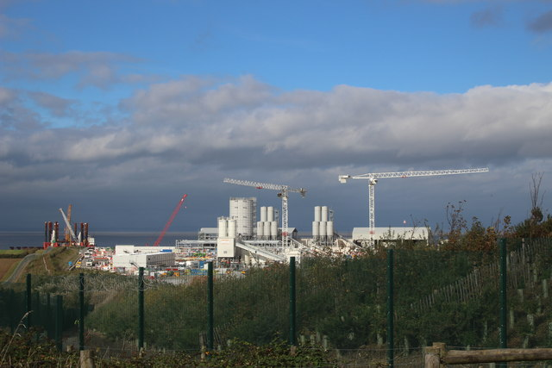
UK Nuclear New Build

Slide 6
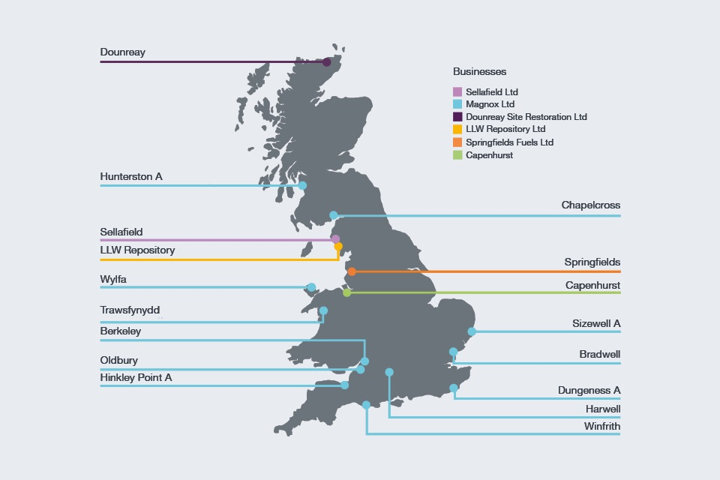
UK Nuclear Decommissioning Authority Sites

Slide 7
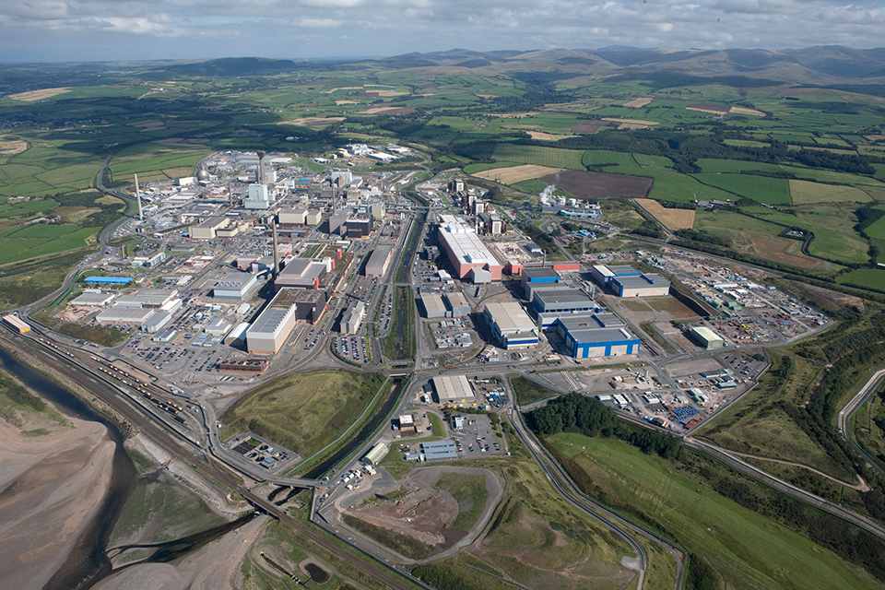
The Sellafield Site

Slide 8
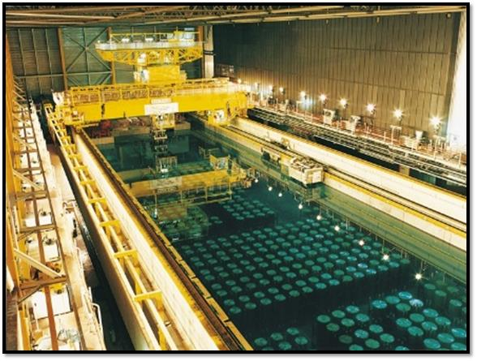
Spent Fuel Management
Thermal Oxide Reprocessing Plant

Slide 9
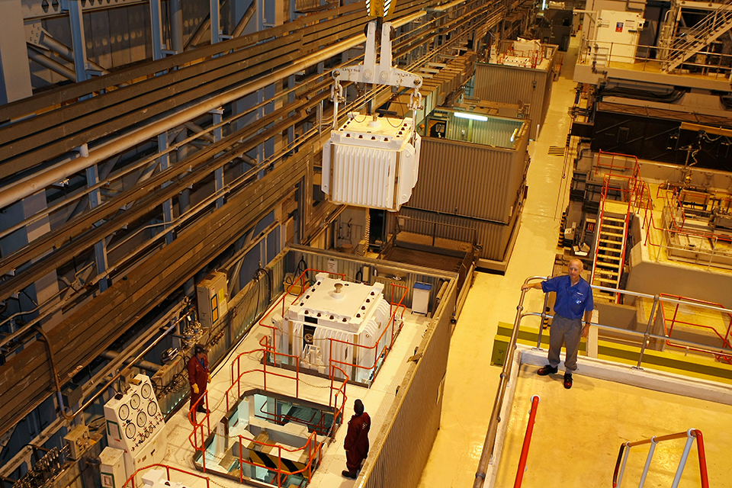
Spent Fuel Management
Magnox Reprocessing

Slide 10
Sellafield - Remediation
Low Level Waste Compaction and Storage

Slide 11
Sellafield - Remediation
Intermediate Level Waste Processing and Storage

Slide 12
Sellafield - Remediation
High Level Waste Vitrification and Storage

Slide 13
Sellafield Work Themes
Retrievals from Legacy Ponds

Slide 14
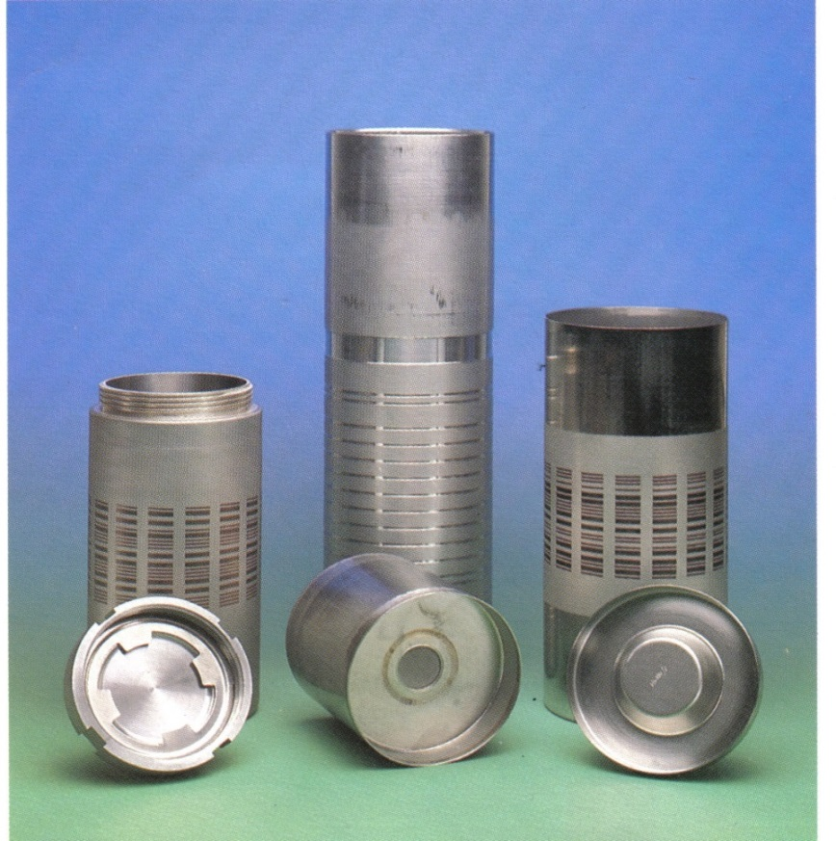
Sellafield Work Themes
Safe and Secure Storage of Nuclear Materials

Slide 15
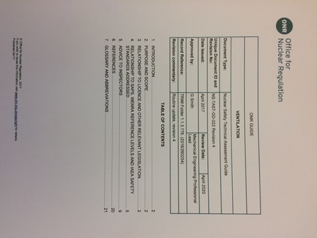
Regulation of UK Nuclear Sites
ONR Licence Conditions and Safety Assessment Principles (SAPs)
ONR Technical Assessment Guides (TAGs)
NS-TAST-GD-022 ONR – Ventilation TAG
Engineering Principles for Containment and Ventilation (ECVs)
Environment Agency Regs
Contains public sector information published by the Office for Nuclear Regulation and licensed under the Open Government Licence v2.0

Slide 16

UK Law
Health & Safety at Work Act
Workplace Regulations
Supply of Machinery Regulations
CDM Regulations
Construction Product Regulations
Fire Safety Regulations
Electricity Safety Regulations
Building Regulations etc, etc…

Slide 17
Non Nuclear Specific Standards
British Standards
ISO Standards
European Standards

Slide 18
Complying with Regulations
ES_0_1738_1
UK Design Guide for Ventilation in nuclear facilities
Also Generic Procurement Specifications and related plant item specific design guides
ES_0_1738_1 is a Work in Progress - evolved from AECP 1054 - to be rebadged as EG_0_1738_1
Change in approach to sizing ventilation air flows – dilution approach gave very high flow rates

Slide 19
Complying with Regulations
Most contaminated areas had highest air changes
Led to increased entrainment & aerial discharges
Flows through primary containment have insignificant effect on activity levels at threshold where it can cause harm to people
Post 1980s designs focus on minimum air flows for process needs and protecting containment boundaries – greatly reduced air flows and plant sizes

Slide 20
Complying with Regulations
ECV 3: Means of Confinement
The primary means of confining radioactive materials should be through the provision of passive sealed containment systems and intrinsic safety features, in preference to the use of active dynamic systems and components
2 examples of passive ventilation designs on the Sellafield site

Slide 21
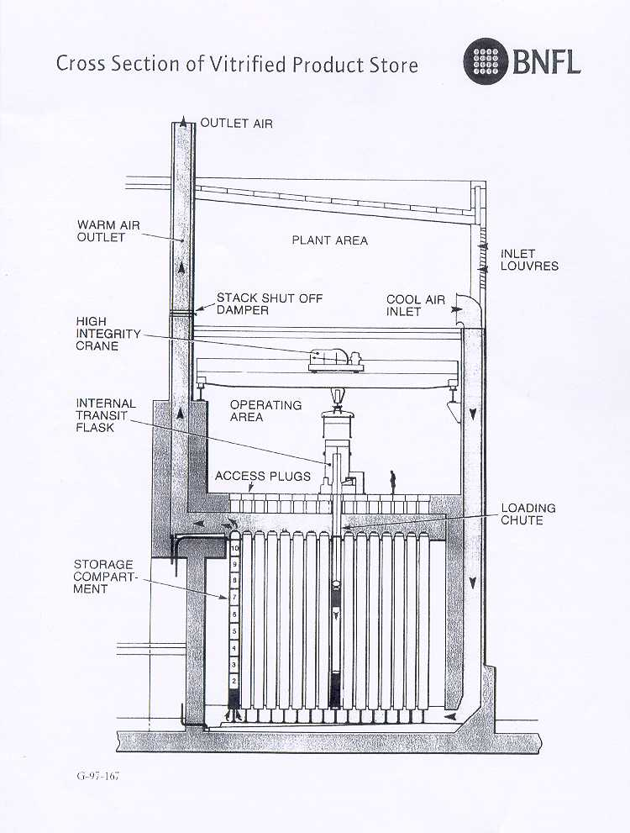
Naturally Ventilated Stores
Vitrified Product Store
HLW product containers vertically stacked in thimble tubes
Natural ventilation cools the outside of thimble tubes
Buoyancy driven cooling

Slide 22
Naturally Ventilated Stores
Product & Residue Store
Decay heat promotes stack effect - multiple containment barriers between air flow and material

Slide 23
Complying with Regulations
ECV 4: Provision of further containment barriers
Where the radiological challenge dictates…plant items that act as containment for radioactive material, should be provided with further containment barrier(s) that have sufficient capacity to deal safely with the leakage resulting from any design basis fault
ES_0_1738_1 adopts the multiple containment barrier approach with ‘cascade’ air flows to support these containment barriers at any breaches

Slide 24

Complying with Regulations
Consider barriers between material and operator
Fresh air in
Discharge
air
Cascade air
Nuclear
Material
Multiple containment barriers
Protecting operator from source

Slide 25
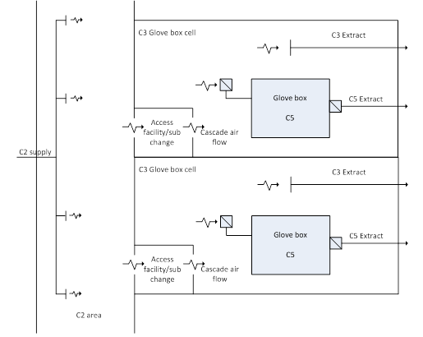
Air Flow Cascade
Across multiple containment barriers

Slide 26
UK Nuclear Ventilation Standards
ES_0_1738_1
Industry Design Guide
Engineering Guides
Design guides for Plant specification
EG_0_1701_1 to EG_0_1720_1
Engineering Standards
Plant Procurement Specifications
ES_0_1701_2 to ES_0_1737_2

Slide 27
Why do we need Nuclear stds?
Many nuclear facilities have 50 plus years operating lives
Facilities often continue to operate well beyond their original design life
Additional costs of replacing worn out plant items on a nuclear licensed site
Vastly disproportionate to the purchase cost alone of failed plant item

Slide 28
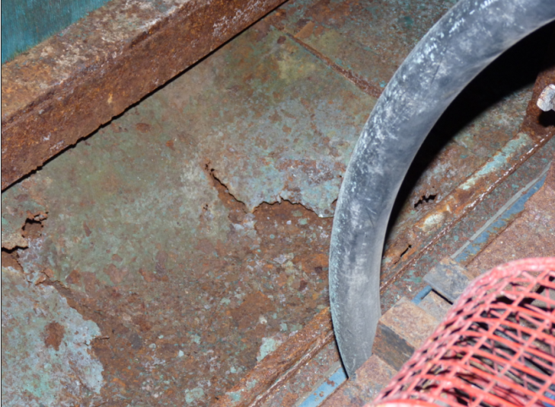
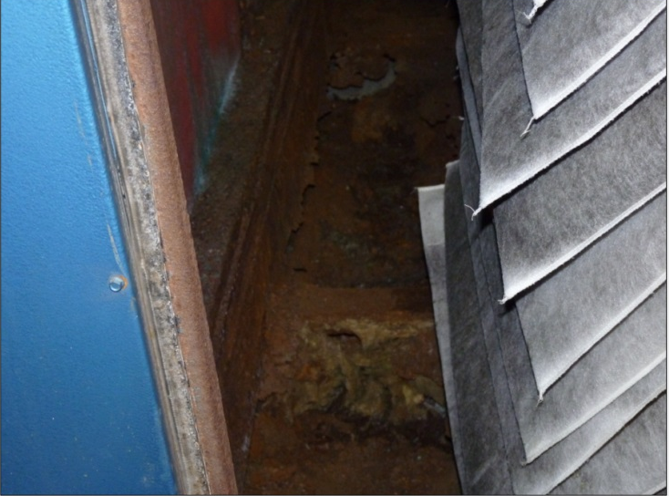
Why do we need Nuclear stds?
Commercial off the shelf plant not always lowest overall facility lifetime cost
Ventilation plant in coastal locations exposed to corrosive salt laden air
High integrity plant needed to prevent contamination leaks
No appropriate BS/EU/ISO plant standards which fully satisfy all requirements

Slide 29
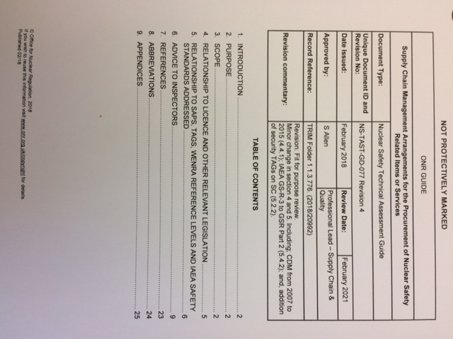
Why do we need Nuclear stds?
ONR Guide on Supply Chain Management Arrangements…
Robust supply chain management needed to avoid counterfeit items
Engineering Standards to include Master Inspection & Test plans
Oversight & assurance arrgts
Contains public sector information published by the Office for Nuclear Regulation and licensed under the Open Government Licence v2.0

Slide 30
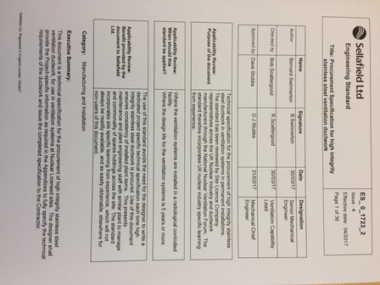
Engineering Standards & Guides
Generic Procurement Specifications for Ventilation Plant Items
Fans, AHUs, ductwork, filter housings, dampers, coils, attenuators
With plant specific options
Each Specification has related Design Guide

Slide 31
Update of Engineering Standards
National Nuclear Ventilation Forum
Site Licence holders and supply chain
Regulators attend the forums
Share good practice and learning from experience
Meets 3 times per year
NNVF Charter - Strategic Priorities
- Skills
- Asset & Ageing Management
- Common UK Standards
Sub-groups to update Engineering Standards

Slide 32
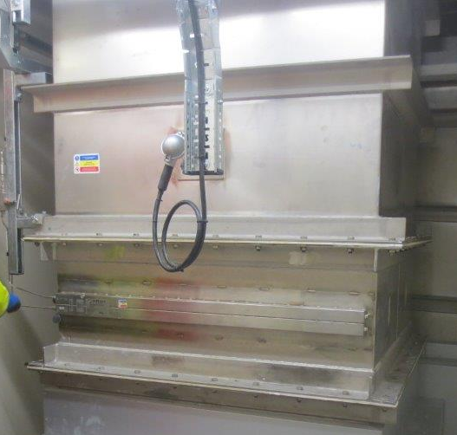
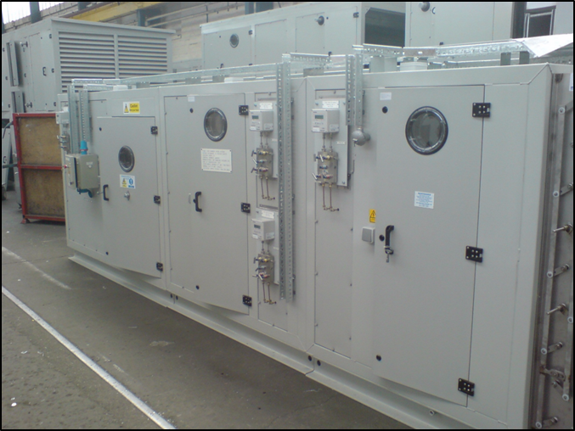
Current Engineering Standards
AHUs
ES_0_1710_2
High integrity ductwork
ES_0_1723_2

Slide 33
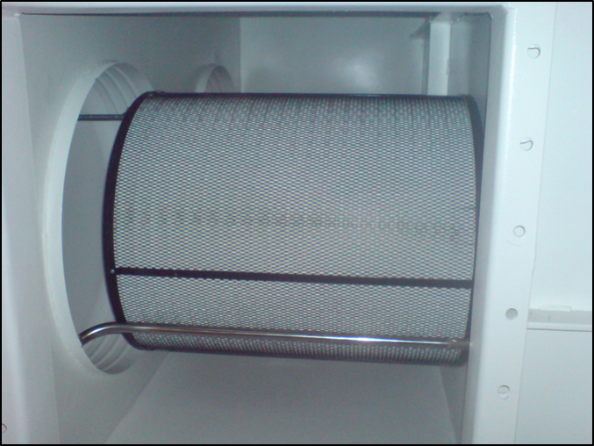
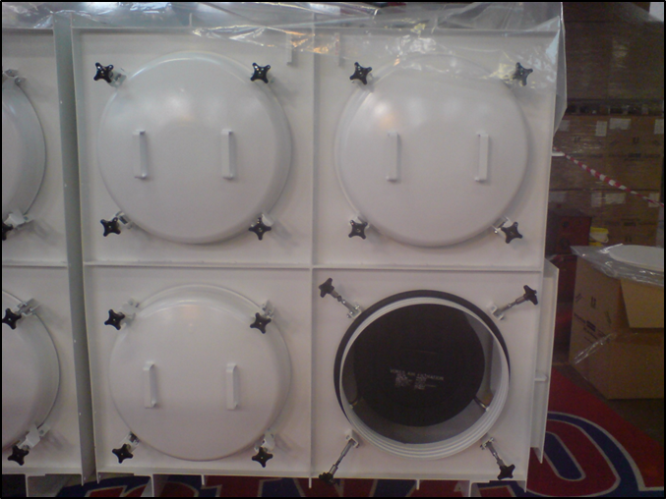
Current Engineering Standards
Photograph courtesy of Fan Systems Ltd
High integrity fans
ES_0_1710_2
Filter housings ES_0_1711_2

Slide 34
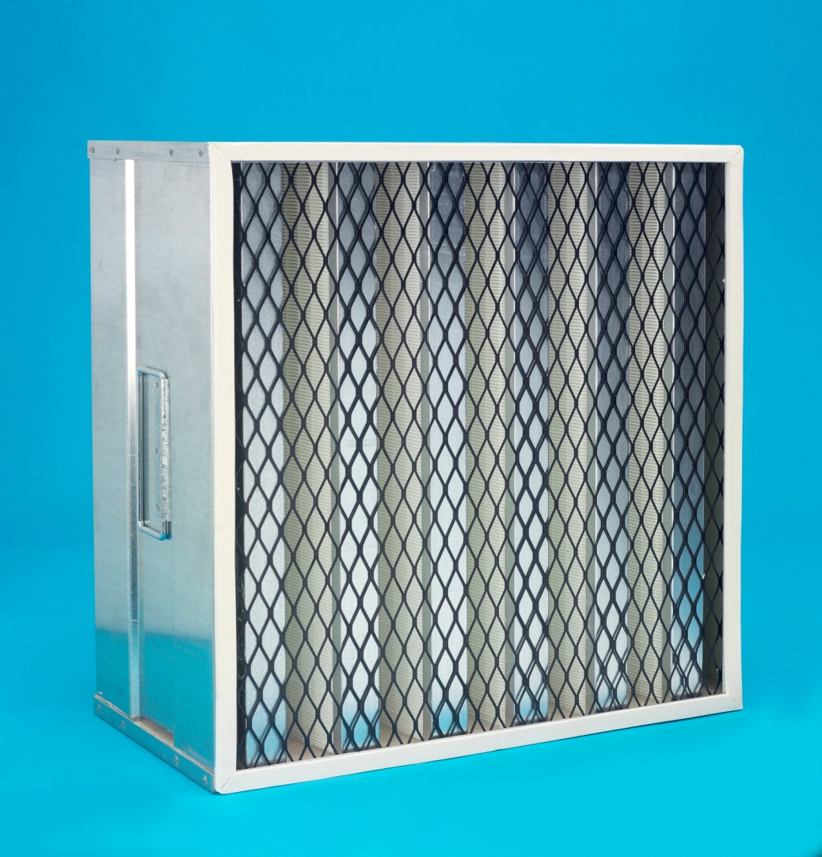
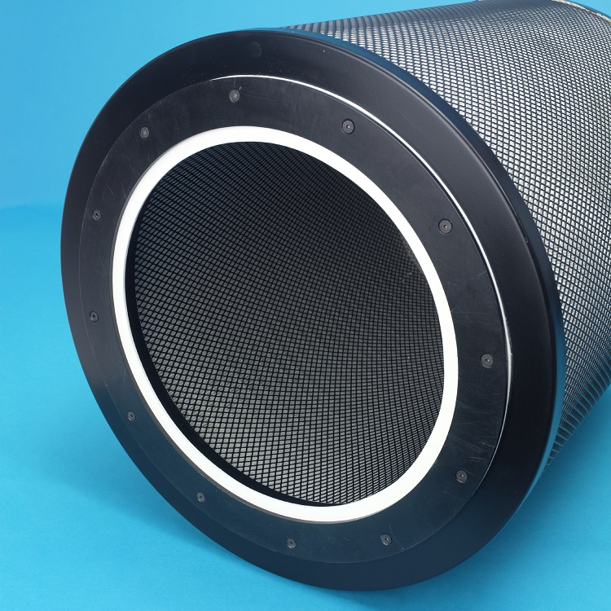
UK HEPA Filter Standards
Photographs courtesy of M.C. Air Filtration Ltd
ES_0_1731_2
ES_0_1737_2

Slide 35
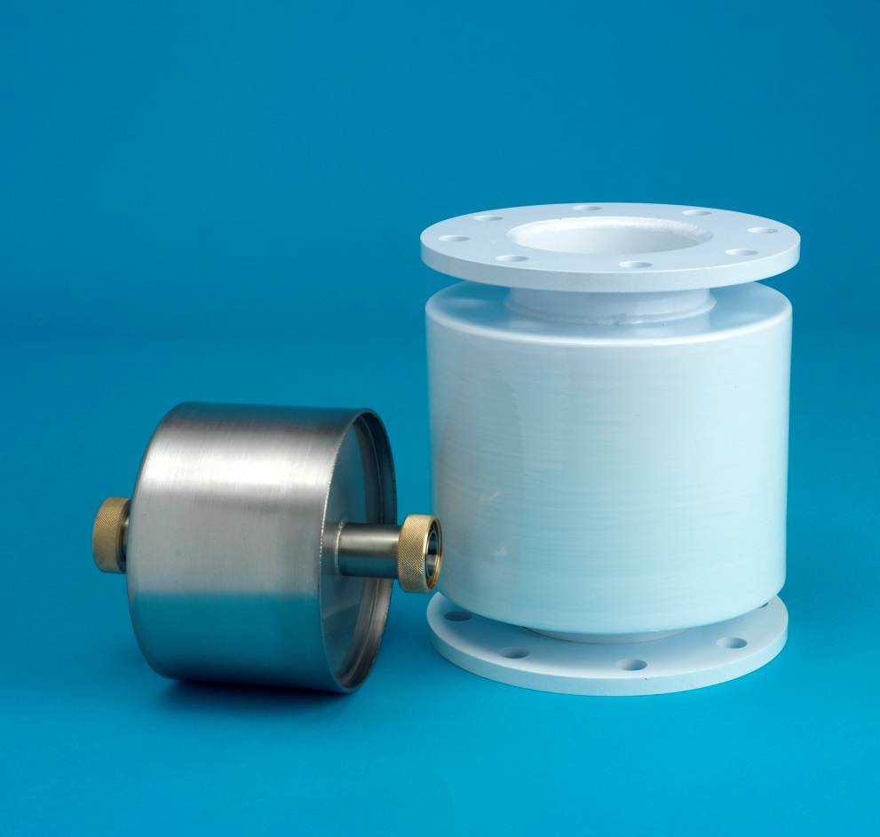
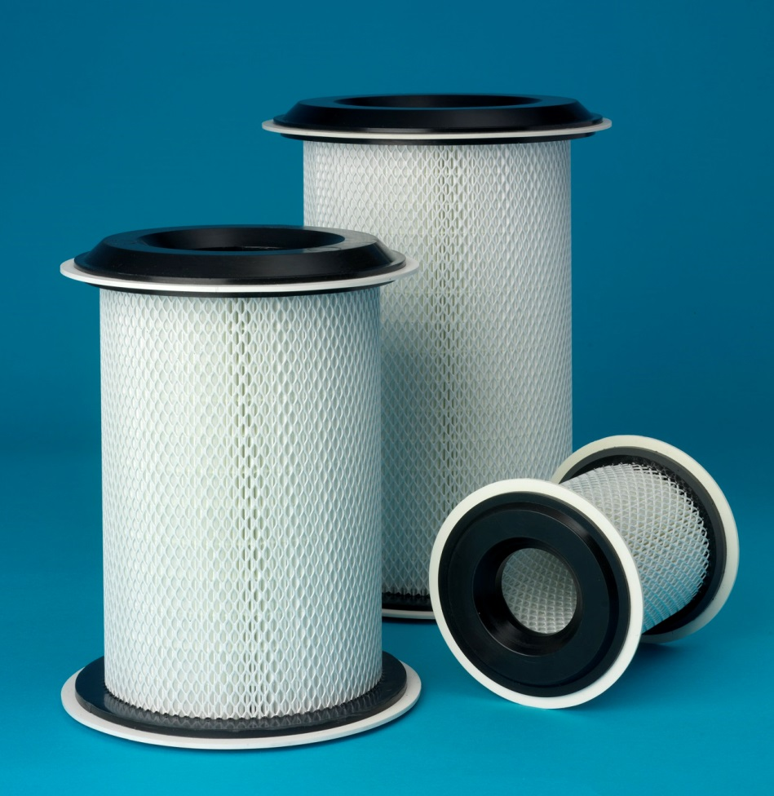
UK HEPA Filter Standards
Photographs courtesy of M.C. Air Filtration Ltd
ES_0_1733_2
ES_0_1735_2

Slide 36
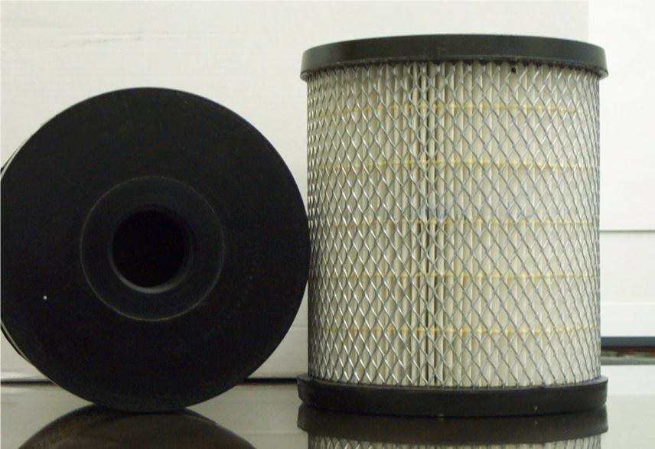
UK HEPA Filter Standards
Photograph courtesy of M.C. Air Filtration Ltd
ES_0_1734_2

Slide 37
Summary
Nuclear Industry Engineering Standards & Engineering Guides
UK Nuclear Regulators ONR SAPs & TAGs
British Standards, EU & ISO Standards
UK Statutory Legislation

