Slide 1
Self-Cleaning Metal Media HEPA Filter Technology
for use in Arduous Environments
Chris Carter, Cavendish Nuclear Ltd, Leicester, United Kingdom
Chris.Carter@cavendishnuclear.com www.cavendishnuclear.com
Chris Chadwick, Porvair Filtration Group, Fareham, United Kingdom
Chris.Chadwick@porvairfiltration.com www.porvairfiltration.com

Slide 2
HEPA Filtration
HEPA Filtration has been established for many decades as a reliable means of controlling environmental release to a known standard.
May be limited in applications by chemistry, temperature, moisture, solids load and radioactivity.
Results in expensive to dispose of secondary or tertiary waste streams (filter element + dust).
A small amount of dust can result in a large volume for processing and disposal.

Slide 3
HEPA Filtration Arduous Environments
Arduous environments for HEPA filtration include:
  High temperature (up to 400 Celsius in oxidising flows)
  High solids loads
  High radioactivity situations
  Aggressive chemical streams
Self-cleaning 316L stainless steel media HEPA filters can operate reliably under all these conditions.
Removes the need to repeatedly dispose of the HEPA cartridge as a secondary or tertiary waste stream.
Returns to the user the small amount of dust which would otherwise result in a large volume for disposal.

Slide 4
Self Cleaning HEPA Filtration
Pulsed Jet Filter cleaning will return the collected solids to the user for removal and disposal, or for re-use.
Safe and reliable cleaning mechanism.
Industrially proven.
Systems can be adapted to provide:
  Remote maintenance and remote removal of the collected dusts.
  Internal ‘Clean-in-Place’ washing systems to remove residual contaminants.

Slide 5
Self Cleaning HEPA Filtration
The metal filter media is limited to 400 Celsius in oxidising atmospheres or up to 500 Celsius in reducing atmospheres.
Higher ∆P compared to conventional HEPA - possibly as high as 10” wg depending on solids load and pulse jet cleaning cycle time.
Equipment size and capital cost can be more than conventional HEPA.
Limited to atmospheres which are 316L compatible.

Slide 6
Pulsed Jet HEPA Filtration
Will maintain >99.97% @ 0.3 micron release levels in the long term.
Increases the range of applications within reach of direct HEPA filtration.
Can simplify process design, eg may be possible to remove the need for spark arrestors, pre-filters, scrubbers etc.
The dust return mechanism can be designed to meet the specific needs of the user for disposal, or re-use, in a controlled fashion.

Slide 7
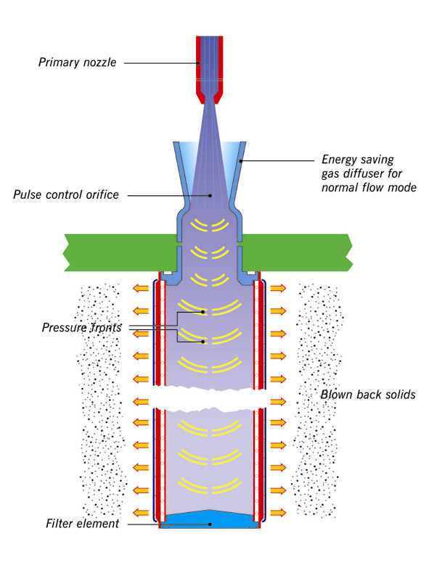
Pulsed Jet Filter Cleaning
Pulsed Jet Filter Cleaning:
Cleaning pulse can be 0.25 second or less.
Cleans in-situ without interrupting the process flow.
Returns dust to the user.
Minimises pressure loss by removing dust build-up on the filter media to operate at a stable ∆P plateau.
Proven and reliable.

Slide 8
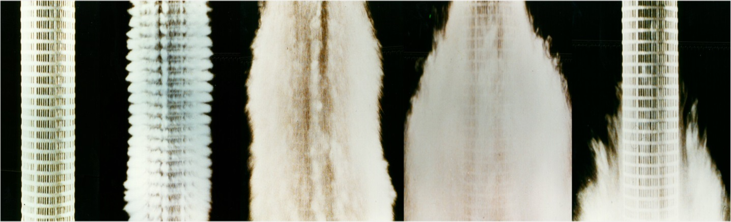
Pulsed Jet Filter Cleaning
1 2 3 4 5
The metal fiber element is loaded with dust;
The dust is removed from the surface by the pulsed jet action;
The dust is carried away;
The dust begins to settle;
The dust falls to the bottom of the vessel leaving a clean element. Overall sequence time ~ half a second

Slide 9
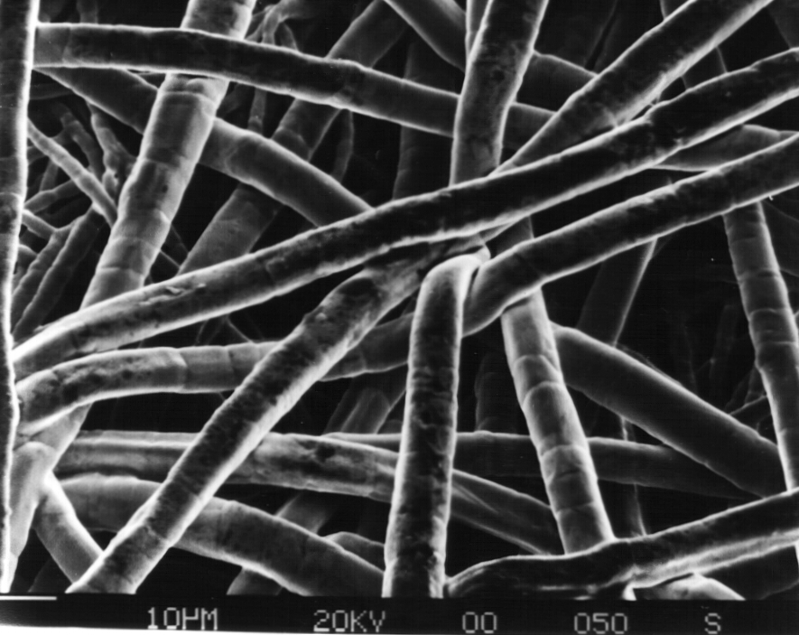
Pulsed Jet HEPA Filtration Filter Medium - Sintered Metal Fiber
Random laid, non woven, matrix.
Metal fibers range 1-30µm.
Sinterbonded - no binders.
Pleatable.
High porosity 60-80%.

Slide 10
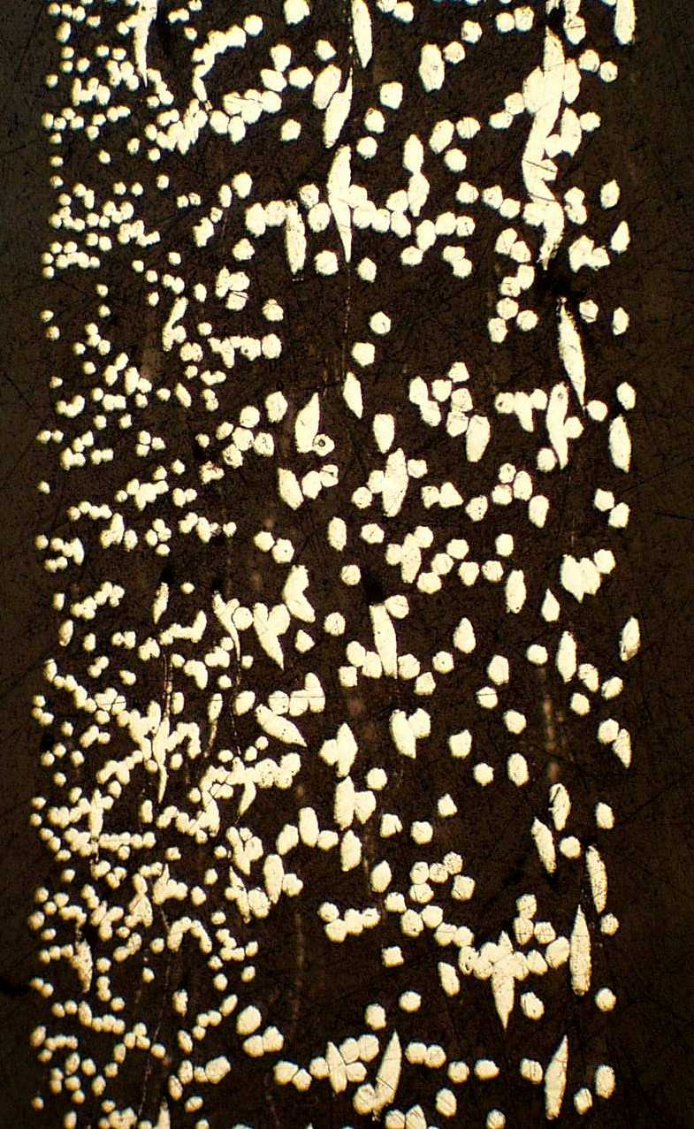
Pulsed Jet HEPA Filtration Filter Medium - Sintered Metal Fiber
Course fiber at rear face provides a support structure
Flow
Fine fiber structure at front face provides surface filtration

Slide 11
Self Cleaning HEPA Filtration Proof of Concept Testing
The following is a summary of some of the development work on test bed Pulsed Jet HEPA filter systems that have been performed at Porvair’s UK research facility using high dust loading at nominally ambient temperature and pressure.

Slide 12
Self Cleaning HEPA Filtration
Test Conditions
Filter element filtration area - 0.3 m² (3.4 ft²).
Target efficiency 99.97% @ 0.3 microns (actual DOP tested efficiency = 99.992% @ 0.3 microns).
Test simulant used was Iron Oxide in the range 0 to 5 microns.
Air flow 32.4 m³/hr (19.2 cfm).
Dust loading rate 108.5 g/hr.
Clean ∆P 2.5” wg.
Initial ∆P set point to start cleaning cycle 4.8” wg.
Adjusted ∆P set point to start cleaning cycle 7.3” wg (raised to see if increased ∆P would affect cleanability.
The MPPS was measured.

Slide 13
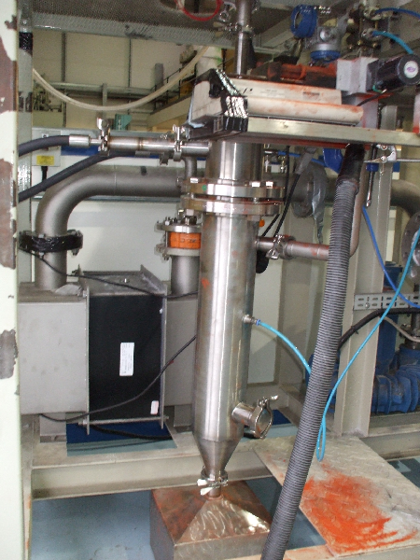
The Test Programme
The test rig consisted of:
Air Flow (Fan and Ducting);
The Filter Vessel;
The Pulsed Jet Cleaning System;
The Dust Injection System;
Dust Recovery and Measurement system;
Instrumentation;
Data Logging equipment.

Slide 14
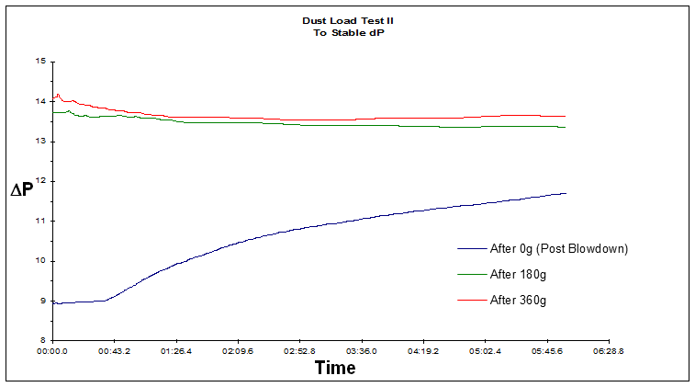
Pulsed Jet HEPA Filtration Tests

Slide 15
Pulsed Jet HEPA Filtration Tests
p
mbar
Initially no pulse cleaning,
P increases
Start of pulse cleaning cycles,
P reduces
Flow
m³/hr
Pulse Pressure
bar.g

Slide 16
Pulsed Jet HEPA Filtration Tests
Start at stable regime ∆P.
Turn off pulse cycle.
Continue to load dust.
⇨ ∆P increases.
ΔP
Time (mins)

Slide 17
Pulsed Jet HEPA Filtration Tests
Summary
Efficiency tests proved the HEPA efficiency before and after the Test Programme - DOP tested efficiency = 99.992% @ 0.3 microns.
∆P data proved that stable long term operation is possible.
MPPS assessment shows actual efficiency at MPPS for the metal filter medium is better than 99.98% @ 0.14 - 0.16 microns.
Self Cleaning metallic filtration technology for arduous environments is proven and is now an industrial reality.

Slide 18
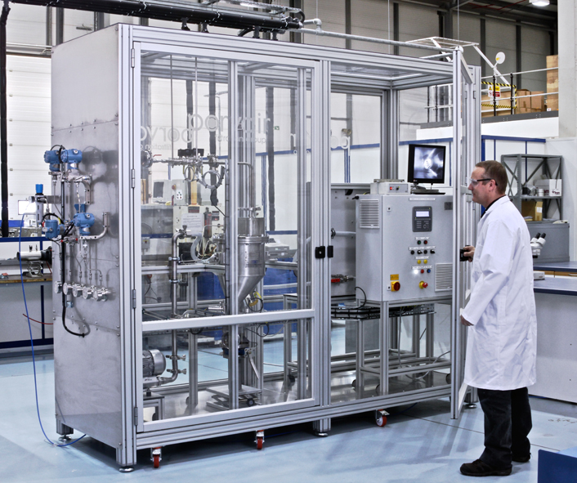
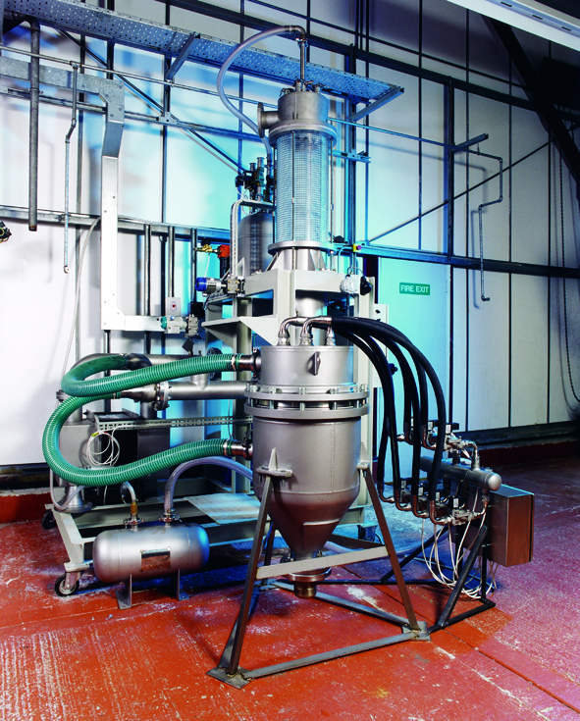
Examples of Pulsed Jet
HEPA Filtration Systems
Mox glovebox filter systems installed in the pellet grinding glovebox and the powder milling gloveboxes at Marcoule, France.
BelogNucleaire Mox fuel facility final grinding glovebox units at Dessel, Belgium.

Slide 19
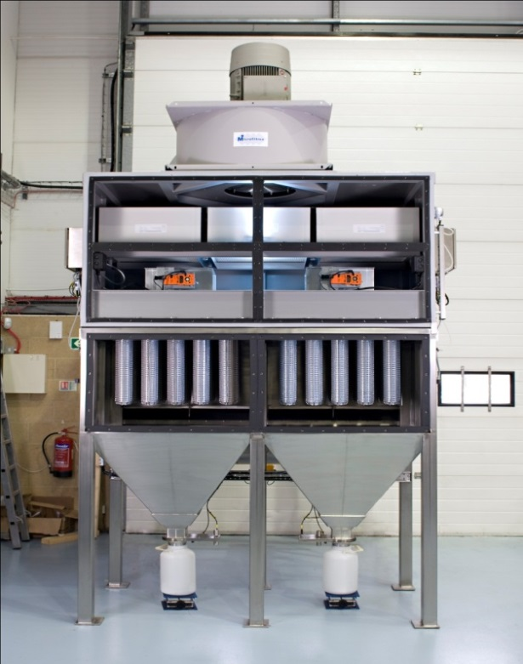
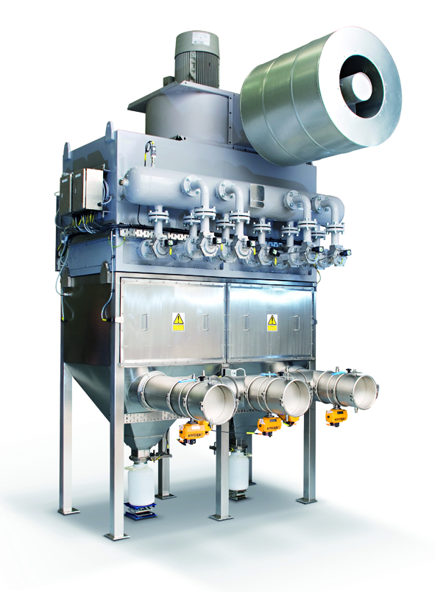
Examples of Pulsed Jet
HEPA Filtration Systems
Franco-Belge de Fabrication du Combustible (FBFC) glovebox venting, centrally filtered venting systems, Dessel, Belgium

Slide 20
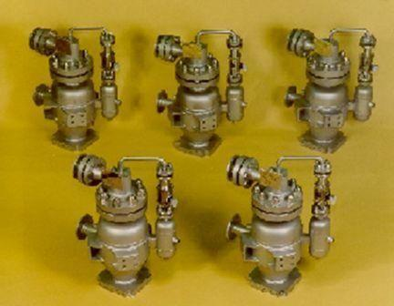
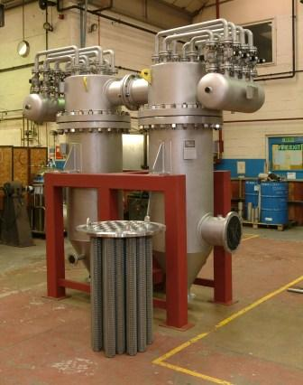
Examples of Pulsed Jet
HEPA Filtration Systems
Demonstration bulk vitrification melter off-gas filters, Richland, WA, USA
Mox Plant sintering furnace off-gas filter system BNFL, Sellafield, UK

Slide 21
Self Cleaning HEPA Filtration Conclusions
The pulsed jet self cleaning metal media HEPA filtration technology has been developed to provide reliable HEPA grade separation in arduous conditions and is particularly relevant in production processes, decommissioning projects and waste management projects where:
  There are high dust burdens and the overall life cycle costs can be reduced by reduction of secondary waste streams.
  The dusts have high radiation source terms and remote/shielded removal of the dusts reduces the dose burden to operators.
  The extracted dusts have a re-use value.
  The working atmosphere is high temperature or corrosive.

Slide 22
Self-Cleaning Metal Media HEPA Filter Technology for use in Arduous Conditions
Thank you!

